Slide 1
C-ME 360 WORKSHOP
From insight to impact.
Unpacking your 360.
COLOUR-PROFILING.COM
Notes:
Welcome slide. Allow the room to settle. Introduce yourself briefly. Do not rush into the agenda.

Slide 2
SETTING THE SCENE
How today works.
1
You have already done the hard part.
2
Today is about application.
Completing and sitting with your 360 report.
Not theory or re-learning the colours. Using your data to create real change.
3
This is a safe space.
4
You will leave with something concrete.
You will not be asked to share numbers or scores with the full group. What you share is your choice.
A personal action plan grounded in your colour profile and your real working relationships.
HOW TODAY WORKS
Notes:
Walk through these points briefly. The aim is to set expectations and lower anxiety. Emphasise the safety norm strongly.

Slide 3



YOUR REPORT AT A GLANCE
Your C-me 360 report: three layers of data.
01
02
03
Preference vs Perception
Perception Gap
Feedback Providers Wheel
Your colour preference percentages compared against how your feedback providers perceive you on average.
Where the gap between self-perception and others' perception is most significant, with a notable / broadly aligned classification.
Where each individual reviewer placed you on the colour wheel, shown alongside your own position for comparison.
THE REPORT
Notes:
Briefly orient participants to the structure of their report before they start working with it. Most will have read it, but not everyone will have noticed all three layers.
Preference vs Perception - Your colour preference percentages compared against how your feedback providers perceive you on average.

Slide 4
MAKING SENSE OF THE NUMBERS
Understanding the perception gap.
↑
Others see MORE of a colour than you do
↓
Others see LESS of a colour than you do
This often signals a strength that is not fully visible to you. You may be undervaluing or underplaying an energy that others find genuinely useful.
This may mean the energy is present but not landing as you intend, or that it is visible in some contexts but not others.
QUESTIONS TO ASK
QUESTIONS TO ASK
Am I holding this energy back deliberately?
What would it mean to own it more fully?
Is this energy getting lost in translation?
What context is shaping how others see me?
THE PERCEPTION GAP
Notes:
A gap is not a problem to fix — it is information to explore. Emphasise this. Participants often catastrophise gaps without unpacking what is actually driving them.

Slide 5
SECTION ONE
Arriving with honesty.
Individual reflection and pair conversation
ARRIVING WITH HONESTY
Notes:
DIVIDER SLIDE: Section 1 — Arriving with honesty

Slide 6

1 · ARRIVING WITH HONESTY · INDIVIDUALLY, THEN IN PAIRS
Complete the sentence.
1
When I first read my 360 report, I felt…
2
The feedback I found easiest to accept was…
3
The feedback that surprised me most was…
SHARE IN PAIRS
One thing that felt useful
One thing you are still not sure what to do with
ARRIVING WITH HONESTY
Notes:
Give 10 mins for individual reflection, then 15 mins for pair conversations. Do not rush. Bring back to the full group with: What was it like to say that out loud?

Slide 7
SECTION TWO
Reading the gap.
Individual reflection and group debrief
READING THE GAP
Notes:
DIVIDER SLIDE: Section 2 — Reading the gap

Slide 8
2 · OPEN YOUR WORKBOOK TO THE GAP MAPPING TABLE.
Reading the Gap
COLOUR | YOUR % | OTHERS SEE % | WHAT MIGHT THIS GAP MEAN?
Red
Yellow
Green
Blue
Bring your own percentages from your 360 report. The conversation is in the gaps, not the numbers.
QUESTIONS
Which gap surprised you most?
Where do others see more of you than you see in yourself?
READING THE GAP
Notes:
Give 15 mins for the individual gap table. Then open to the group. You do not need everyone to share. Invite those who noticed something unexpected.

Slide 9
SECTION THREE
The gap behind the gap.
Trio conversation
THE GAP BEHIND THE GAP
Notes:
DIVIDER SLIDE: Section 3 — The gap behind the gap

Slide 10
3 · THE GAP BEHIND THE GAP · IN GROUPS OF THREE
Listen with curiosity.
01
One person shares their most significant
gap and explores it out loud for 5 minutes.
QUESTIONS THAT WORK WELL
What do you think is driving that?
When does it show up most, or least?
What would it look like if the gap were smaller?
What would you lose if you changed this?
02
The other two listen and ask questions only. No advice. No interpretation. Just curiosity.
03
Rotate until everyone has had a turn.
THE GAP BEHIND THE GAP
Notes:
Brief the trio carefully. The 'no advice' rule is the whole point. If people start problem-solving, gently bring them back to questions. 5 mins per person is enough.

Slide 11
SECTION FOUR
Unpacking the questions.
Individual reflection and pair conversation
UNPACKING THE QUESTIONS
Notes:
DIVIDER SLIDE: Section 4 — Unpacking the questions

Slide 12
4 · UNPACKING THE QUESTIONS
Two stories, one picture.
Your C-me profile gives you a language for your preferences. The additional questions give you information about your impact in this specific context.
REFLECT
What additional themes came through in the questions section of my report?
How does this feedback connect to, or contrast with, what my colour profile tells me?
Is there a pattern across both layers? What is it pointing at?
Where do the two stories align?
Where do they create an interesting tension?
UNPACKING THE QUESTIONS
12 / 22
Notes:
You will not know what the additional questions are. That is fine. Your role is to help participants find the connection between the two data sources, not to interpret specific questions.

Slide 13
SECTION FIVE
Strengths worth keeping.
Individual reflection
STRENGTHS WORTH KEEPING
Notes:
DIVIDER SLIDE: Section 5 — Strengths worth keeping

Slide 14
5 · STRENGTHS WORTH KEEPING
Before we look at what to change,
what is genuinely working?
BLUE
RED
Analytical
Precise
Detail-oriented
Thorough
Questioning
Driven
Competitive
Results-focused
Strategic
Assertive
GREEN
YELLOW
Supportive
Patient
Cooperative
Steady
Empathetic
Social
Enthusiastic
Optimistic
Engaging
Spontaneous
STRENGTHS WORTH KEEPING
Notes:
Keep this section shorter than it feels like it needs to be. Its job is to counterbalance the deficit pull of 360 feedback, not to become a full strengths inventory.
For each colour
What strength did others confirm?
What might you risk losing if you over-correct?

Slide 15
SECTION SIX
Choosing what to change.
Individual reflection and feedforward
CHOOSING WHAT TO CHANGE
Notes:
DIVIDER SLIDE: Section 6 — Choosing what to change

Slide 16
6 · CHOOSING WHAT TO CHANGE
Not everything needs to become
a development goal. Choose what is genuine.
OPTION ONE
OPTION TWO
OPTION THREE
Dial up
Dial back
Deploy more deliberately
Bring more of this energy. It may be there but not landing.
This energy may be overplayed or landing harder than intended.
The energy is there. Use it with more intention in specific contexts.
CHOOSING WHAT TO CHANGE
16 / 22
Notes:
The dial up / dial back / deploy more deliberately frame is the key conceptual tool here. Then move into the feedforward exercise.

Slide 17
EXERCISE
The feedforward exercise.
1
Choose one behaviour you want to develop.
2
Ask two different people:
"I am working on [behaviour] . What is one suggestion you have for how I could do this more effectively going forward?"
THE RULE: Listen and say thank you. Do not defend, explain or qualify. Just receive.
AFTER: Which suggestion is still with you? What made it land?
FEEDFORWARD
17 / 22
Notes:
Brief this carefully. The no-defending rule is the entire point of feedforward. If participants start explaining themselves, gently interrupt and redirect.

Slide 18
SECTION SEVEN
Making it real.
Relationships and context
MAKING IT REAL
Notes:
DIVIDER SLIDE: Section 7 — Making it real

Slide 19
7 · MAKING IT REAL: RELATIONSHIPS AND CONTEXT
Change happens in specific conversations.
PERSON / RELATIONSHIP
THEIR LIKELY COLOUR
WHERE DOES MY GAP SHOW UP?
ONE THING I'D DO DIFFERENTLY
—
—
—
—
—
—
—
—
—
—
—
—
The conversation I have been putting off that my 360 is telling me to have…
MAKING IT REAL
Notes:
Encourage participants to name a real person for each row, not a role type. The relationship prompt at the bottom often produces the most significant insight of the day.

Slide 20
SECTION EIGHT
Your personal colour
action plan.
Individual work and commitments
PERSONAL COLOUR ACTION PLAN
Notes:
DIVIDER SLIDE: Section 8 — Your personal colour action plan

Slide 21
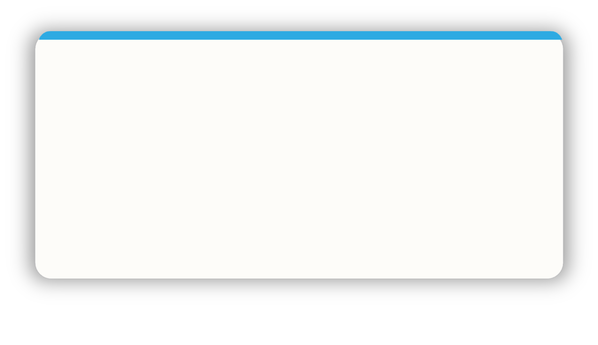
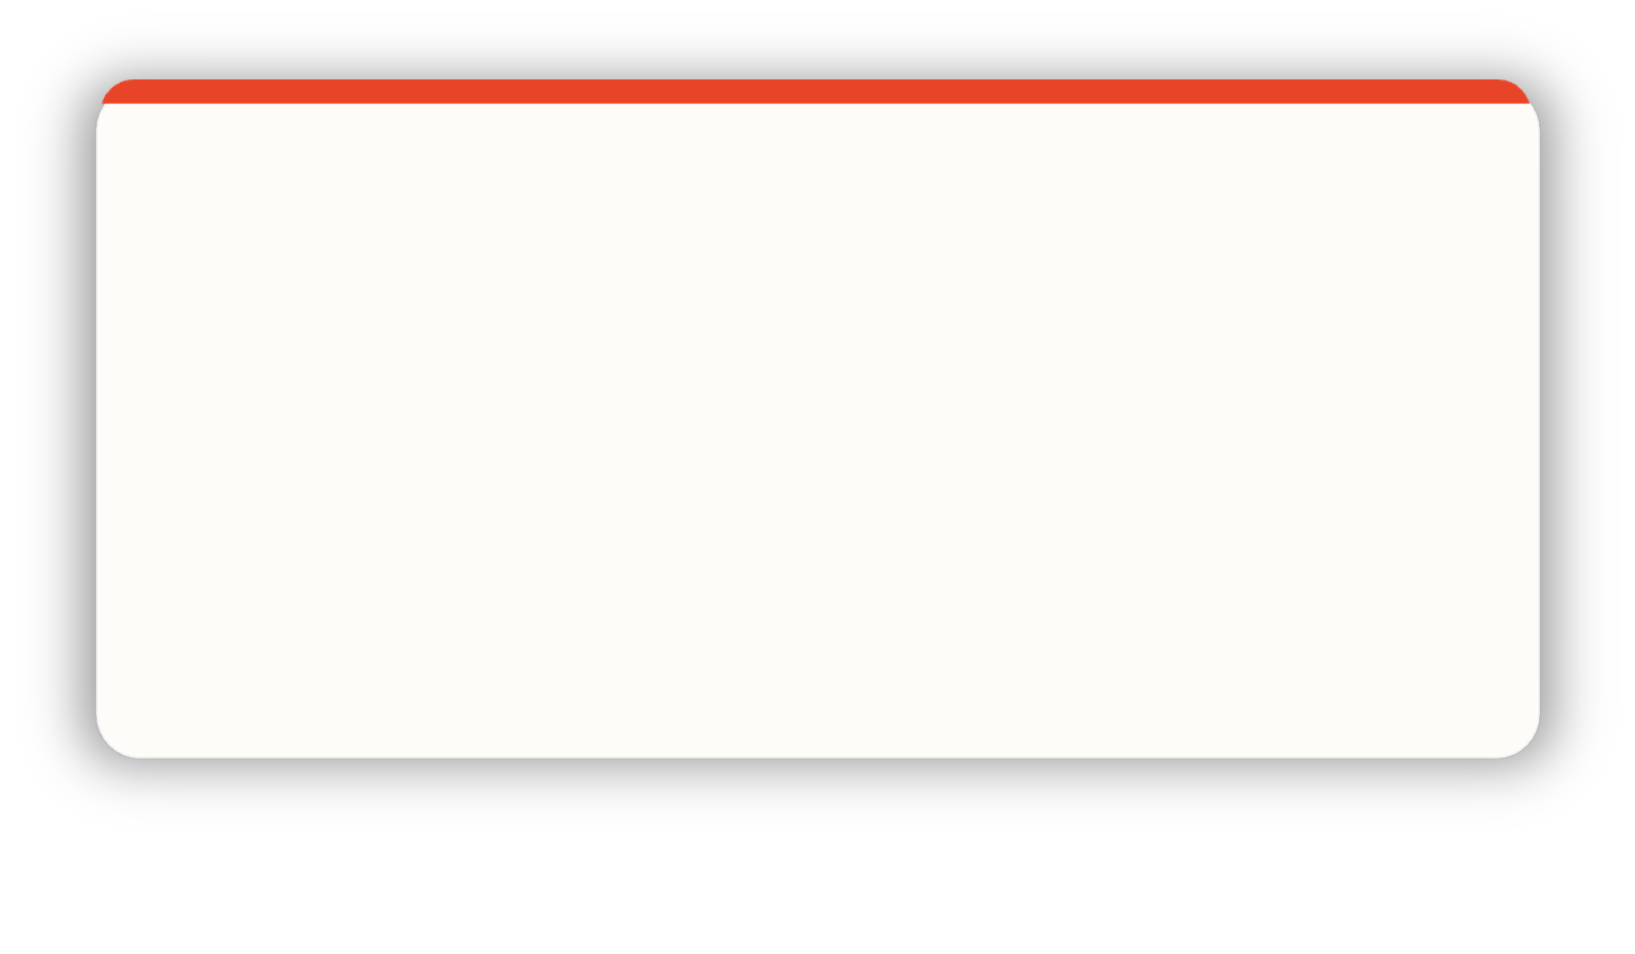
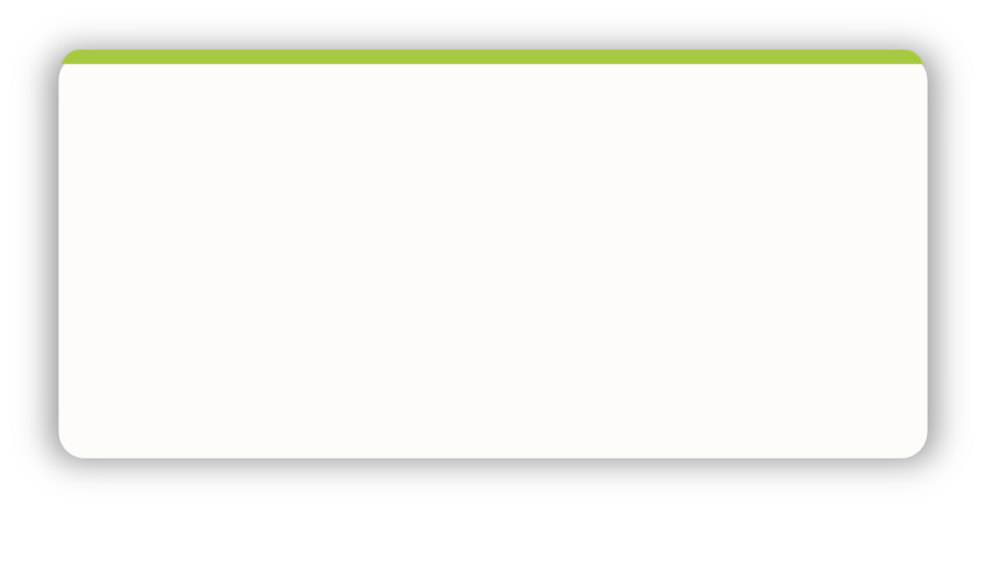
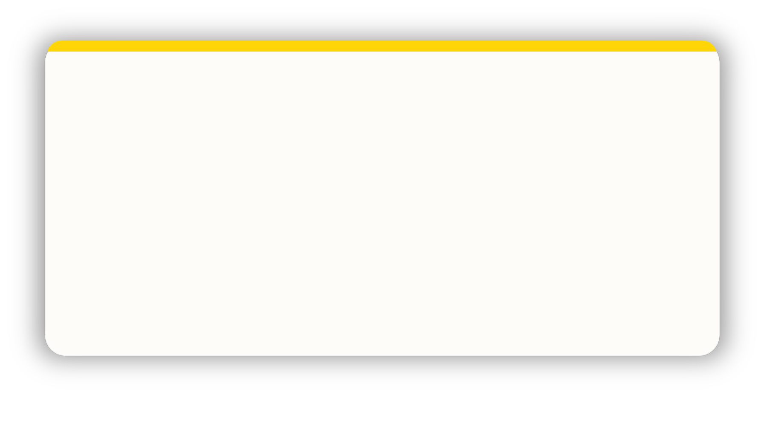
8 · YOUR PERSONAL COLOUR ACTION PLAN
One genuine commitment per colour.
Quality over completeness.
Each colour has a different perspective on the focus for action.
What behaviour will I dial up, dial back, or deploy more deliberately?
What behaviour will I dial up, dial back, or deploy more deliberately?
Consider all 4 colours to reflect on what you have learnt today.
What behaviour will I dial up, dial back, or deploy more deliberately?
What behaviour will I dial up, dial back, or deploy more deliberately?
ACTION PLAN
Notes:
Get people to write this down. Allow 20 mins for individual writing. Then bring the group together for headline commitments. One sentence each. No commentary. Powerful close.

Slide 22
THE CLOSE
One commitment.
COLOUR-PROFILING.COM
Notes:
Ask Each person to share their one headline commitment in one sentence. Do not let there be commentary, explanation or questions.. Let there be a moment of quiet after the last person speaks. Do not end on housekeeping.

