Slide 1
FACILITATOR NOTES · PRE-SESSION
Preparing for your C-me session.
Certain slides can be hidden (right-click ‘Hide Slide’) depending on session needs. Certain slides will need editing for each session — see checklist below.
1
C-me profile
A C-me profile is needed for every participant.
2
Home slide
Option to add the client’s or team’s logo / brand to Slide 3.
3
Bespoke team data
Insert the team’s Team Wheel and Team Graphs on Slide 9.
4
Bespoke scenarios
Tailor Exercise 5 on Slides 11 & 22 with scenarios relevant to this team.
CHANGE MANAGEMENT WORKSHOP
Notes:
Pre-session admin slide. Run through the checklist before delivery: every participant needs a C-me profile completed; add the client's logo to the home slide (slide 3); insert the bespoke Team Wheel and Team Graphs on slide 9; tailor Exercise 5 on slides 11 and 22 with scenarios relevant to this team.

Slide 2
FACILITATOR NOTES · DELIVERY
Session delivery.
We encourage you to run through all the slides ahead of delivering them in slideshow mode. Some slides are static and others include animations — please check that the animations work as expected.
Brief notes are provided below each slide to give delivery guidance.
Notes:
Run through every slide ahead of delivery in slideshow mode. Some slides are static, others have animations — check they fire as expected. Brief facilitator notes appear under every slide for delivery guidance.

Slide 3

C-ME CHANGE MANAGEMENT WORKSHOP
Change Management Workshop.
Helping teams communicate, collaborate and perform at their best.
COLOUR-PROFILING.COM
01 / 25
Notes:
If delivering remotely: welcome everyone in grid view (share slides later). Give a brief personal introduction. State the purpose of the workshop and the timeline for today. If you're recording the session, let the clients know at the start.

Slide 4

OUR AIMS FOR THIS SESSION · WHAT ARE YOURS?
Our aims for
this session.
01
Reflect on the specific contributions of each team member
02
Consider the 4 pillars of high-performing teams: how robust are you in handling setbacks, change and recruitment?
03
Understand how to maximise engagement and buy-in
04
Personal and team reflection
OUR AIMS
02 / 25
Notes:
Check these aims are appropriate for your clients and tailor if necessary. Give space for participants to share their session aims in the chat or aloud.

Slide 5
RECAP · ALL FOUR COLOURS BRING SOMETHING TO THE TEAM
Natural team contribution.
Attends to the detail
Questions the team’s methods
Focuses on getting things right
Keeps the team to process
Brings organisation skills
Prepares for all eventualities
Sets stretching goals
Confronts poor performance
Gets on with the job
Builds consensus
Ensures everyone has a say
Focuses on values
Focuses on the task in hand
Spots the flaw in the plan
Holds the team accountable
Keeps the team together
Remembers the good things
Supports those who need it
Motivates the team
Encourages participation
Explores new ways
Promotes a positive approach
Spreads warmth + energy
Inspires the team
TEAM CONTRIBUTION
Notes:
Recap: ALL have something to bring to the team. Can also refer to individual statements on Team Contribution in the profile and/or Team Wheel to support this recap.
Additional questions to consider:
For your team, are there particular contributions that are perhaps overlooked?
What does the newest member of your team bring to the team?
Which colour preference is least represented in your team?
Does that impact the value that colour preference brings?

Slide 6

FOUNDATIONS
4 pillars of high-performing teams.
10 · HIGH
PILLAR 01
PILLAR 02
PILLAR 03
PILLAR 04
Commitment
Flexibility
Honesty
Resilience
Bought into the journey.
Focus & adaptation.
Tricky conversations.
Handling setbacks.
PROFILE · ENABLING ENGAGEMENT
PROFILE · EFFECTIVE & INEFFECTIVE COMMS
PROFILE · HANDLING SETBACKS
PROFILE · ROLE AGILITY
1 · LOW
Relationships
4 PILLARS
Notes:
Outline the 4 Pillars of High Performing Teams
Each "click" reveals new pillar.
A commitment to the culture that sits underneath a team will make the difference between Performance and High Performance
Each Pillar is linked to a section of profile
Commitment – Enabling Engagement section
Flexibility – Role Agility section
Honesty – Effective and Ineffective Communication sections
Resilience – Handling Setbacks sections
Fifth “click” RELATIONSHIPS – that underpin all 4 pillars
Final Click – reveals scale. What would you score yourself/your team for each of the 4 pillars? (1 = low, 10 = high)

Slide 7
EXERCISE 1 · REFLECTING ON YOUR PROFILE
Score yourself.
For each of the 4 pillars, on a scale of 1–10 (10 = high) , how would you score yourself?
PILLAR 01
PILLAR 02
PILLAR 03
PILLAR 04
Commitment
Flexibility
Honesty
Resilience
Bought into the journey.
Focus & adaptation.
Tricky conversations.
Handling setbacks.
REFLECT
What are the barriers to your scores being higher?
Reflecting on your profile, how could you improve your performance?
EXERCISE 1
05 / 25
Notes:
Encourage referral to their individual profiles for statements to consider as they answer the questions.

Slide 8
EXERCISE 2 · REFLECTING ON YOUR TEAM’S PERFORMANCE
Score your team.
For each of the 4 pillars, on a scale of 1–10 (10 = high) , how would you score your team - and the reason why?
PILLAR 01
PILLAR 02
PILLAR 03
PILLAR 04
Commitment
Flexibility
Honesty
Resilience
Bought into the journey.
Focus & adaptation.
Tricky conversations.
Handling setbacks.
SHARE
Each team member shares their scoring - observe the variety.
EXERCISE 2
06 / 25
Notes:
Encourage each team member to share their scoring for the team individually, to see the variety of scores. Encourage them not to change their answers based on hearing other people's scores. This could be done in pairs or small groups if the group is large or to encourage more honesty.

Slide 9

EXERCISE 3 · UNDERSTANDING HOW WE OPERATE
High performance as a team.
DISCUSS
PLACEHOLDER
Which of the 4 pillars come naturally to this team in order to be high-performing?
Insert Team Wheel and Team Graphs exported from the C-me platform.
Which come less naturally?
EXERCISE 3
07 / 25
Notes:
Invite reflection and discussion on team wheel
Which of the 4 pillars come naturally to this team in order to be High Performing?
Which come less naturally to this team in order to be High Performing?

Slide 10

EXERCISE 4 · TEAM CHALLENGES · SIGNS AND ACTIONS
Handling Setbacks
01
02
Referring to your own statements, how could you improve your team’s ability to handle setbacks?
What would the outcome of this be for your team?
SIGNS OF STRESS
SIGNS OF STRESS
SIGNS OF STRESS
SIGNS OF STRESS
Withdrawn & quiet
Over-analysing
Critical of self / others
Indecisive
Aggressive & impatient
Domineering
Short-tempered
Cuts corners to win
Withdrawn & passive
Avoids conflict
Over-accommodating
Stubborn or resentful
Overly emotional
Loses focus, jumps tasks
Talks more, listens less
Disorganised
MANAGING STRESS
ACTIONS
ACTIONS
ACTIONS
ACTIONS
Give time & space to think
Provide clear info & data
Avoid surprises
Acknowledge their standards
Be direct & brief
Offer choices & control
Focus on results
Channel energy into action
Listen patiently
Reassure & show support
Give steady, clear plans
Invite their honest view
Give recognition
Allow time to talk it out
Help re-prioritise
Keep it positive & light
EXERCISE 4
Notes:
Each person's contribution to improving things as a whole. Reference the Resilience / Handling Setbacks section of the individual profile.

Slide 11
EXERCISE 5 · TEAM CHALLENGES
Apply the 4 pillars.
What would it look like for your team to implement the 4 pillars - commitment, flexibility, honesty, resilience - for each of the following scenarios?
SENARIOS
01
An attitude issue.
02
A significant team loss.
COMMITMENT
Bought into journey
FLEXIBILITY
Focus + adaptation
HONESTY
Tricky conversations
RESILIENCE
Handling setbacks
03
A collective team mistake.
EXERCISE 5
09 / 25
Notes:
Construct a scenario that touches on these 3 issues: 1. Collective team motivation (an attitude issue); 2. Sudden loss of a valuable team member; 3. A situation where the team felt the impact of mistakes that had been made. Tailor these scenarios for the team you are delivering to.

Slide 12
EXERCISE 6 · TEAM CHALLENGES
Handling change.
POSITIVE
NEGATIVE
What have been your most positive experiences of change initiatives?
What have been your most negative experiences?
REFLECT
How might this link to your colour preference?
EXERCISE 6
10 / 25
Notes:
Invite reflection and discussion in pairs about positive and negative experiences of change initiatives — and how these might link back to colour preference.

Slide 13

STAGES OF GRIEF · WIDELY APPLIED TO CHANGE MANAGEMENT
Kübler-Ross model of change
Integration
Denial
Decision
MORALE
+
PERFORMANCE
Frustration
Shock
Experiment
Depression
TIME
11 / 25
KÜBLER-ROSS
Notes:
1st reveal:
Kübler-Ross model is sometimes called the Stages of Grief Model
Named after the psychiatrist Elisabeth Kubler-Ross
First published in her 1969 book “Death and Dying”
Has been widely applied to business and change management
Looks at how morale and performance fluctuates through various stages of change over time
2nd reveal: Stages appear
We will all go through these different stages at different times.
Different colour preferences will go through them at different speeds and have different places where they are most likely to get “stuck”

Slide 14
C-ME AND CHANGE · HOW EACH PREFERENCE RESPONDS
C-me + change.
✓
Planned, safe, improving, evidenced
✓
Ambitious, fast, beneficial, impactful
✗
Unplanned, risky, disruptive, unknown
✗
Small, slow, low growth
✓
Values driven, people minded, long term
✓
Innovative, vision led, connecting people
✗
Top-down, hurried, financially driven
✗
Time consuming, unclear, impersonal
C-ME AND CHANGE
12 / 25
Notes:
Ticks = Positive ways that Colour Preference responds to change
Crosses = Change dynamics that will cause that Colour Preference frustration

Slide 15

EXERCISE 7 · TEAM CHALLENGES
Recruitment change: New Team Members
DISCUSS
How could an awareness of colour preference bring value to your recruitment process?
EXERCISE 7 · RECRUITMENT
13 / 25
Notes:
Mention the Recruitment profile – a great resource
Invite discussion
New members of the team will cause change and adjustment. Knowing the colour preference of new team members can help with faster integration and relationship building.

Slide 16

PAUSE · REST · RESET
Break.
BREAK
14 / 25
Notes:
Break time. Confirm length and exact return time before they leave the room.

Slide 17

Maximising engagement fuels commitment.
10 · HIGH
PILLAR 01
PILLAR 02
PILLAR 03
PILLAR 04
Commitment
Flexibility
Honesty
Resilience
Bought into the journey.
Focus & adaptation.
Tricky conversations.
Handling setbacks.
PROFILE · ENABLING ENGAGEMENT
PROFILE · EFFECTIVE & INEFFECTIVE COMMS
PROFILE · HANDLING SETBACKS
PROFILE · ROLE AGILITY
1 · LOW
Relationships
4 PILLARS
04 / 25
Notes:
Focus here on the first 2 pillars
Note.
Honesty – for tricky conversations: Covered in Comms and Conflict Workshop
Resilience – handling setbacks: Covered in Stress and Resilience Workshop

Slide 18
DISCUSS
How could you maximise the contributions made to your team from each of the different colour preferences?
ENGAGEMENT · DISCUSSION
16 / 25
Notes:
Invite discussion: how could you maximise the contributions made to your team from each of the different colour preferences? Note: the next slide reveals some 'answers'.

Slide 19
C-ME AND MAXIMISING ENGAGEMENT · DO
How to maximise engagement.
Communicate key info in advance
Make the logical case
Identify risks
Invite feedback
Make the logical case for change
Ask for help identifying risks
Optimise likelihood for success
Invite to lead
Communicate early
Clarify need + show benefit
Invite necessary support
Communicate in small groups
Invite feedback
Sell the vision
Communicate with energy
Invite ideas
Focus on the positives
MAXIMISING ENGAGEMENT
17 / 25
Notes:
Walk through the do's by colour for maximising engagement. These are the levers for each colour preference — the actions that build buy-in and commitment.

Slide 20
C-ME AND DECREASING ENGAGEMENT · DON’T
What drains engagement.
Gloss over details
Surprise them
Let them abandon current tasks
Skip the evidence
Display too much emotion
Mask truth behind change agenda
Tell them last
Silence disagreement
Forget people impact
Launch publicly first
Silence disagreement
Tell them last
Imagine the vision sells itself
Surprise them
Leave them out of new initiatives
Dampen creativity
DECREASING ENGAGEMENT
18 / 25
Notes:
Walk through the don'ts by colour. These are the patterns that drain engagement and commitment for each colour preference.

Slide 21
EXERCISE 8 · MAXIMISING ENGAGEMENT
Engagement · Role fit around the wheel.
STEP 01 · ON YOUR OWN
Right way to do things
Judgement
Unemotional decisions
Pick 2 actions you’d like to focus on from the Enabling Engagement section in your profile.
Details, logical
Analyses problems
Gets it right
Decisive, direct
Certain, determined
Moves on quickly
Processes, step by step
Steady
Sense of duty
Positive
Enthusiastic, fast paced
Optimistic, new ideas
STEP 02 · IN PAIRS
Pair with someone whose colour combination differs from yours . How could you help them maximise engagement?
Understanding
Focuses on values
Considerate, caring
Interactive
Quickly builds rapport
Engages in conversation
Empathy, Supporting
Trusting
Takes a personal interest
EXERCISE 8
Notes:
Explore / Filter / Share. Pick 2 actions from your Enabling Engagement section (page 8 in PDF).
Then pair up with someone whose colour-preference combination differs from yours and discuss what you could do to help them maximise their engagement.

Slide 22
EXERCISE 9 · WHICH COLOUR BUYS IN FIRST?
Colour preference + buy in
In the following scenarios, which colour preference is likely to buy in first?
01
02
03
04
05
New growth strategy
Communications innovation
Culture change
Purchasing new tech equipment
National growth plan
EXERCISE 9 · BUY-IN
Notes:
Tailor these scenarios for the team you are delivering to. Ask the room which colour preference is likely to buy in first to each scenario, and why.

Slide 23
C-ME COLLABORATION MODEL · PERFORMANCE INCREASE
C-me collaboration model.
High trust requirement
Innovative (some risk)
COLLABORATION
Strategic (give up a bit/gain a lot)
People capability and opportunity focused
Collaborative leverage
TRUE VALUE
Significant gains
03
PERFORMANCE
Some trust required
Win/win
CO-OPERATION
Some leverage 1 + 1 = 3
Part process part people
Teamwork
WORKING TOGETHER
Marginal gains
02
Low trust requirement
Low risk/reward
EFFICIENCY
No waste solutions
Mainly about process
Individual
PROCESS
Minimal gains
01
COLLABORATION MODEL
Notes:
Explain the Collaboration Model. A bit like Maslow's Hierarchy of Needs — if a lower level is threatened, collaboration reduces. As you work up the stages (1–3), performance increases. Note: each click reveals the explanation of the next stage. Invite discussion on what stage the team feels they spend most of their time in. What might it take to increase the amount of time spent in the co-operation, and particularly the collaboration, stages?

Slide 24

EXERCISE 10 · COLLABORATION MODEL
The collaboration model: Application
Imagine you were given 10 units to allocate between the 3 levels .
How would you apportion them to represent the time and effort your organisation and team currently spend in each level?
COLLABORATION
03
__ /10
TRUE VALUE
02
CO-OPERATION
__ /10
WORKING TOGETHER
01
EFFICIENCY
__ /10
PROCESS
EXERCISE 10
22 / 25
Notes:
Exercise to assess the level of collaboration in your team / organisation. Ask each participant to allocate 10 units across the three levels to represent how their time and effort is currently spent. As an example, many organisations would apportion along the lines of:
- six or seven in Efficiency
- two or three in Co-operation
- 0 or one in Collaboration

Slide 25
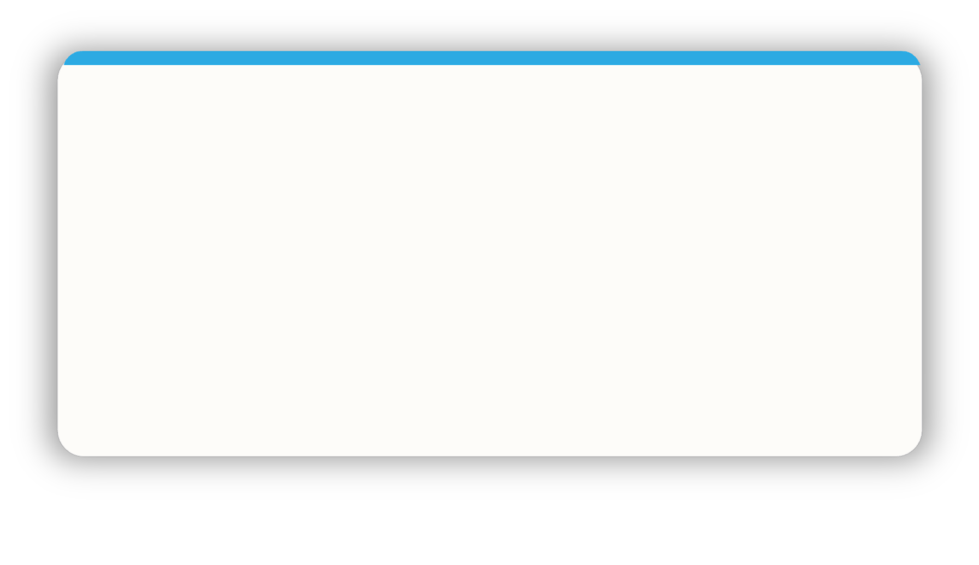
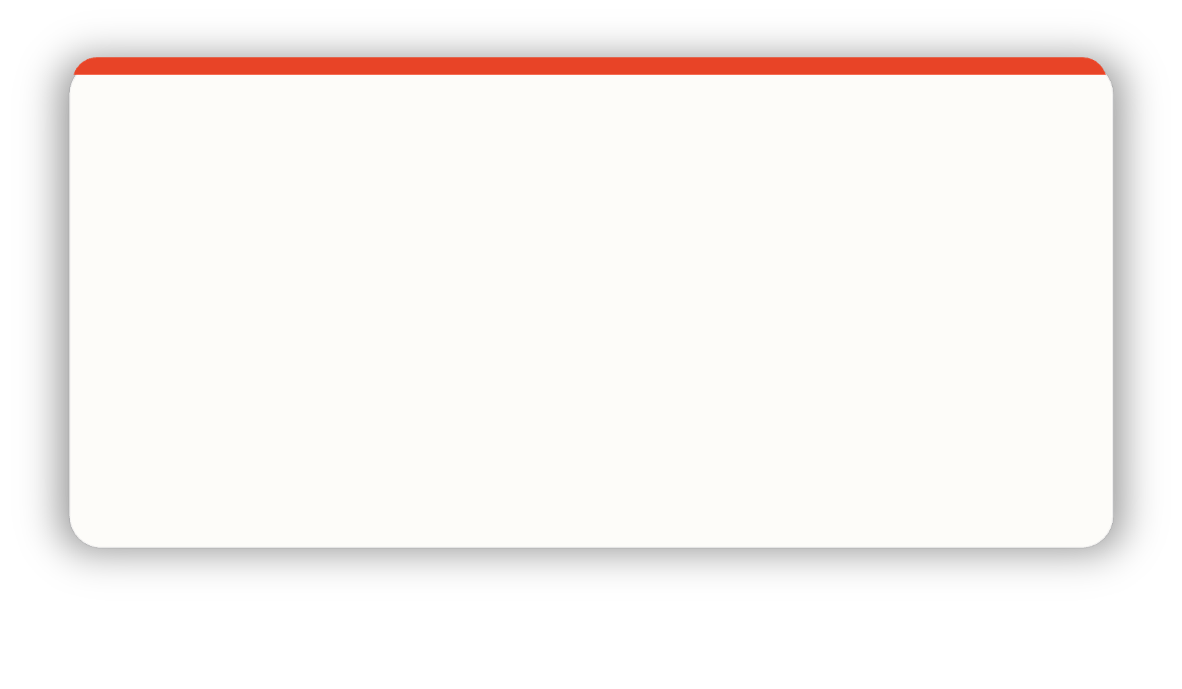
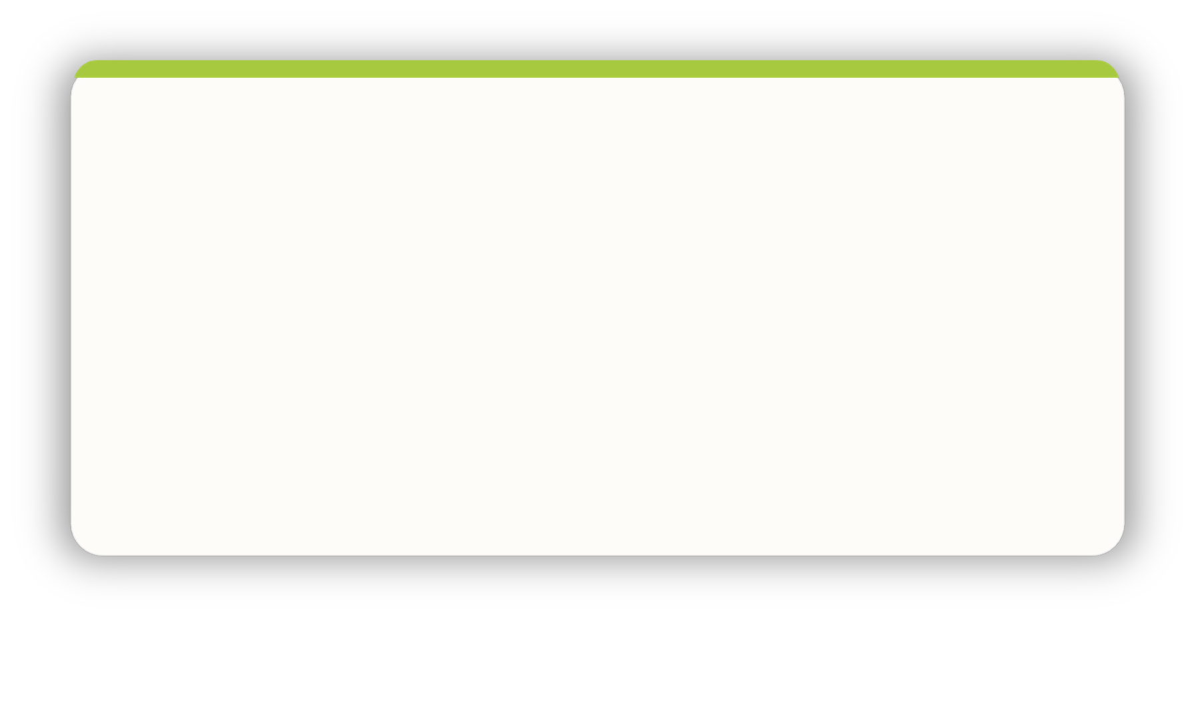
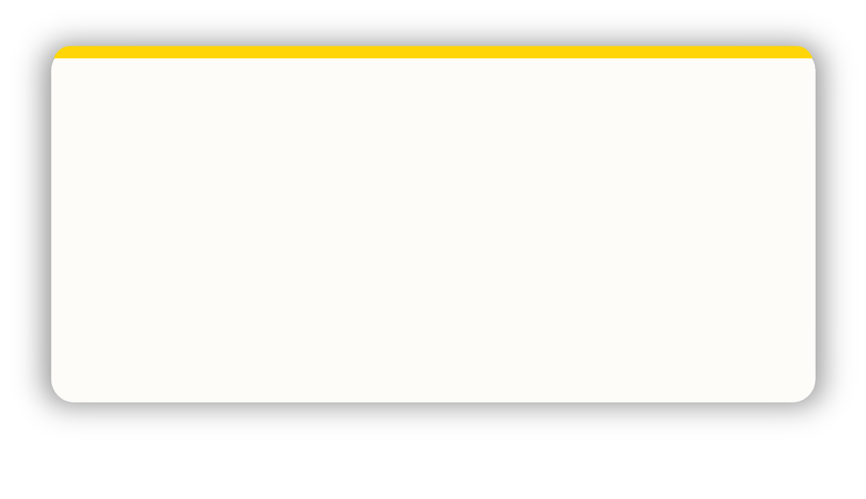
NEXT STEPS · THROUGH ALL 4 COLOURS
Personal reflection
What more do I want to know?
What are my personal goals?
Each colour has a different perspective on the focus for action.
Consider all 4 colours to reflect on what you have learnt today.
How could this impact others?
How can this be applied?
What do you want to
stop … start … continue ?
PERSONAL REFLECTION
Notes:
Committing to actions to put into practice what we’ve covered over these sessions helps
to increase the impact of what you’ve learned.
We’ve mapped action planning around our wheel, illustrating how different elements look
through different colour lenses.
We all draw on all 4 colour energies in our daily lives, regardless of go to preferences, it’s just
that some we may have to be more intentional about than others …
Red – what personal goals are you going to set?
Yellow – what innovative applications can you think of?
Green – what impact might this have on others – how can I leverage what I’ve learned to impact
my team?
Blue – what theory and knowledge do I want to remember from this session?
STOP/START/CONTINUE: a helpful structure for reflection. What will you Start doing?
Stop doing? Continue doing?
Action: take 5mins now to complete this page.
Action: I’d like you all to enter in the chat box one key action point you’ve included in your plan …
Further comments you might want to make:
You or your client may want to include this in a personal development plan.
Personal commitments: goal orientation and ambition.
Innovative application: creative ideas around how you can apply what you’ve learned – at home, in meetings,
new ways to share or communicate insights, new ways to use your personalised C.
Impact on others: how can I leverage what I know to impact the teams I am a part of – share profiles and insights,
use to coach or line manage, use the team wheel for team meetings to create awareness of potential dynamics
and styles, enhancing comms and inclusivity.
Theory and knowledge: key takeaways from the sessions – we’re all different and unique? how to spot bad day
behaviours?

Slide 26
NEXT STEPS · THROUGH ALL 4 COLOURS
Team
reflection
What more do we want to know?
What are our personal goals?
Reflect on what you have learnt today through the lens of all 4 colours.
As a team what do you want to stop … start … continue ?
How could this impact others?
How can this be applied?
TEAM REFLECTION
Notes:
Opportunity for TEAM Reflection – vital to help embed the learning from this workshop in a collective way.
Encouragement to reflect on team group behaviours through the lens of all 4 colours (whilst we have a behavioural preference,
we are all a blend of all 4 colours).
STOP/START/CONTINUE: a helpful structure for reflection.

Slide 27
STAY IN TOUCH
Thank you.
Please stay in touch. We’d love to hear how you’re putting this into practice.
colour-profiling.com
@colourprofiling
@cmeprofiling
Cmecolourprofiling
@C-me Colour Profiling
CHANGE MANAGEMENT WORKSHOP
25 / 25
Notes:
Opportunity to thank everyone. Insert your own links on this slide — replace the social handles with your studio's links if relevant before delivery.

