Slide 1
FACILITATOR NOTES · PRE-SESSION
Preparing for your C-me session.
Certain slides can be hidden (right-click ‘Hide Slide’) depending on session needs. Certain slides will need editing for each session — see checklist below.
1
C-me profile
A C-me profile is needed for every participant.
2
Home slide
Option to add the client’s logo / brand to Slide 3.
3
Aims
Adjust session aims as appropriate for the client on Slide 4.
4
Team materials
Insert the team wheel on Slide 8 and team graphs on Slide 9.
COMMUNICATION & CONFLICT
Notes:
Pre-session admin slide. Run through the checklist before delivery. Certain slides can be hidden (right-click 'Hide Slide') depending on session needs. Certain slides will need editing for each session — see the list. Every participant needs a C-me profile completed.

Slide 2
FACILITATOR NOTES · DELIVERY
Session delivery.
We encourage you to run through all the slides ahead of delivery in slideshow mode. Some slides are static and others include animations — please check that animations work as expected.
Brief notes are provided below each slide to give delivery guidance.
COMMUNICATION & CONFLICT
Notes:
Run through every slide ahead of delivery in slideshow mode. Some slides are static and others include animations — please check that animations work as expected. Brief notes are provided below each slide to give delivery guidance.

Slide 3

C-ME WORKSHOP
Communication + conflict workshop.
Helping teams communicate, collaborate and perform at their best.
COLOUR-PROFILING.COM
Notes:
If delivering remotely:
Welcome everyone on grid view (share slides later).
Give a very brief personal introduction
Purpose: The purpose of this workshop is ……
Programme: The timeline for today is ….
If recording the session: Let the clients know at the start.

Slide 4


OUR AIMS FOR THIS SESSION · WHAT ARE YOURS?
Our aims for
this session.
01
Explore different communication styles
02
Gain key strategies to engage successfully in challenging conversations
03
Develop greater effectiveness in receiving feedback
04
Gain key strategies to help navigate confrontation and conflict
What are your aims…?
OUR AIMS
Notes:
Check these aims are appropriate for your clients and tailor if necessary.
Click to reveal the question 'What are your aims?' Give space for participants to share their session aims in the chat (if remote) or aloud (if in-person).

Slide 5

EXERCISE 1 · SELF-REFLECTION
Self-reflection.
01
02
03
How comfortable do you find communicating with others?
What do you think you are like to talk to?
How attentive are you as a listener?
SELF-REFLECTION
Notes:
Exercise 1 — self-reflection. Three questions, revealed on each click. Allow space for the room to sit with each one before moving on.

Slide 6

Thinking
preference
EXERCISE 2 · GROUP REFLECTION
Remember C-me +
the Jungian axes?
Reflective preference
Expressive preference
REFLECT + DISCUSS
How does behavioural preference impact how we communicate with others?
Feeling
preference
JUNGIAN AXES
Notes:
Reminder of the Jungian axes introduced in the Foundation Workshop. Let's look at the axes C-me uses to echo Jungian psychology — helping to introduce another layer to interpreting the colour wheel. Then prompt the group reflection: how does behavioural preference impact how we communicate with others?

Slide 7

C-ME PREFERENCE AROUND THE WHEEL
The C-me colour wheel
A keen eye for detail
Brings clarity to complexity
Direct and to the point
High-impact style
BLUE
002
BLUE
014
RED
015
RED
002
Enjoys problem solving
Explores all options
Bold and determined
Enjoys taking the lead
BLUE
041
BLUE
062
RED
047
RED
028
Aligns vision, values and behaviour
Considers impact on others
Brings positivity to any problem
Expressive and persuasive
GREEN
033
GREEN
051
YELLOW
033
YELLOW
005
A calming influence
Builds consensus
Flexible and adventurous
Juggles many tasks at once
GREEN
109
GREEN
012
YELLOW
021
YELLOW
066
THE WHEEL
Notes:
Let’s start by looking at the C-me colour wheel - the heart of
our approach to behavioural preference + how we represent them at C-me.
It’s a blended colour wheel – and this is important because it reflects that we flex our behaviours to move
around the wheel – the key here is that you can move, you're not stuck, there is room to develop and grow. Colours
blend, numbers and labels don’t.
This is a non-binary/non-dualistic approach – not boxing you in but giving you a common language to understand
preference diversity and improve communication.
We’ve grouped similar behaviours by colour and mapped them onto the wheel for learning purposes – we’ll unpack
this further as we go on.

Slide 8
YOUR TEAM WHEEL
Team wheel.
INSERT TEAM WHEEL
TEAM WHEEL
Notes:
Reflect on the team wheel. Questions to get discussion going: What are the strengths of this team? What other observations do you have? How do the colour preferences of the team impact on team communications? How do you see this playing out?

Slide 9
YOUR TEAM GRAPHS
Team graphs.
INSERT TEAM GRAPHS
TEAM GRAPHS
Notes:
Insert team graphs. Use this slide to walk the team through their adapted vs natural behaviour and how this might be playing out day-to-day.

Slide 10
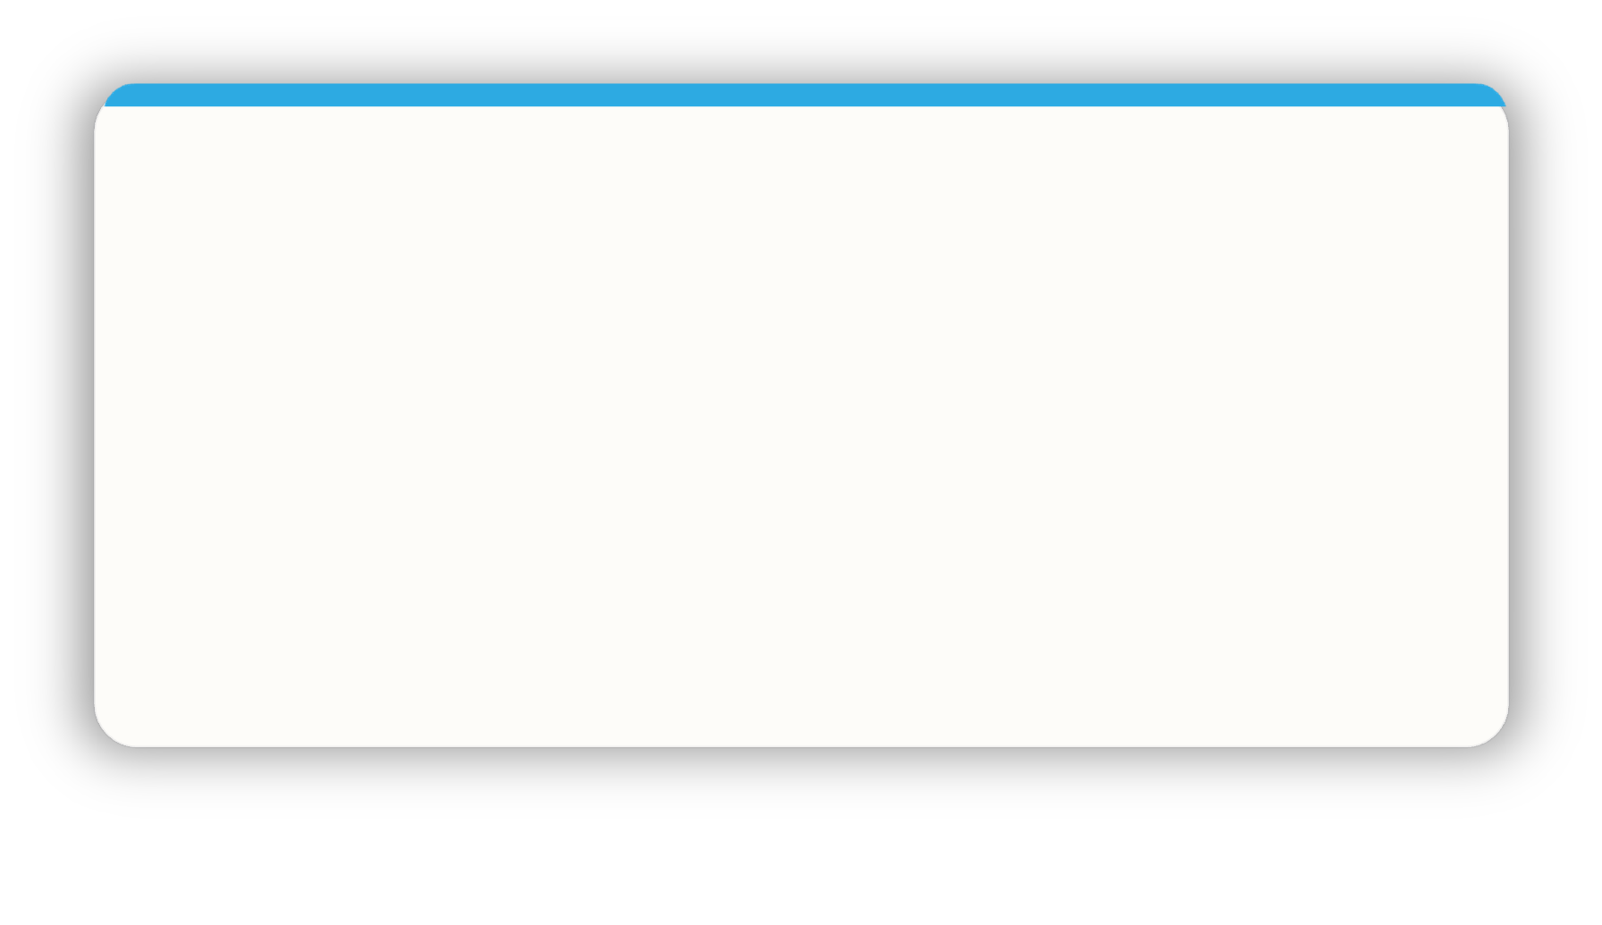
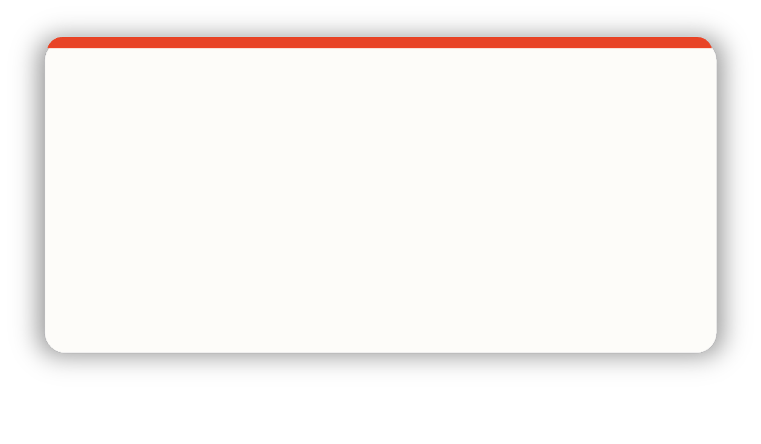
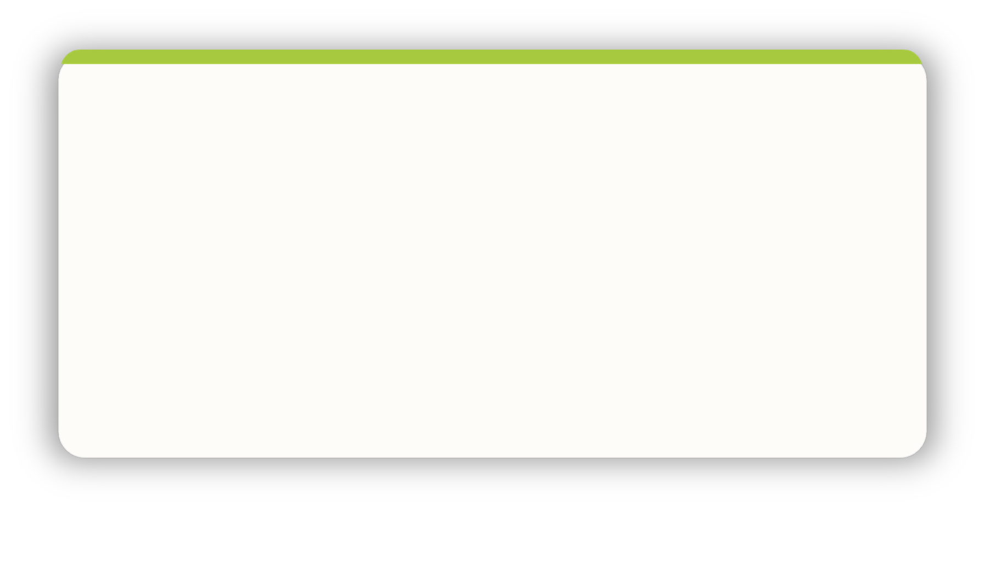
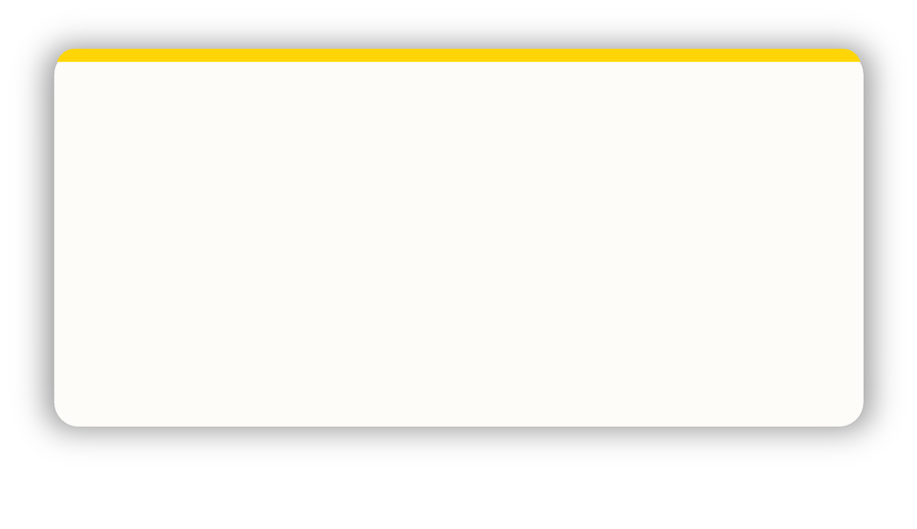
EFFECTIVE COMMUNICATION · DO …
Effective communication.
Be logical + thorough
Give me time to prepare
Be rational + practical
Ask me for my thoughts
Be clear + brief
Refer early to the objective
Demonstrate conviction
Identify my role quickly
Allow conversation to be free flowing
Use visuals
Be interactive + informal
Let me shape the outcome
Listen carefully
Show sincere interest
Involve others
Allow time for discussion
EFFECTIVE COMMUNICATION · DO
Notes:
DO…
Effective colour communication. Colours have an influence both on what we do say but also on what we don't say.
Action: identify your lowest 2 colours. Be aware that these will be other people's highest colours — you may need to flex your approach to communicate more effectively with them. Pick 2/3 specific bullet points from your lowest colour that you want to try to put into practice.
For those who are a cross-type profile, use their lowest colour or the colour at the bottom of their 'C' visual.

Slide 11




INEFFECTIVE COMMUNICATION · DON'T …
Ineffective communication.
Skip over the facts
Stray from the agenda
Interrupt my thinking
Be flippant
Be impatient
Procrastinate
Slow down the pace
Repeat yourself
Be abrupt
Rush me
Talk over me
Openly criticise
Restrain my ideas
Overwhelm with detail
Dampen my enthusiasm
Expect me to stick to rigid timescales
INEFFECTIVE COMMUNICATION · DON’T
Notes:
DONT
Ineffective colour communication. This visual is again reinforcing colour-preference behaviours and encouraging people to consider other colours than their own.
Ineffective colour communication. Action: again, looking at your lowest 2 colours, identify 2/3 specific statements that you may need to avoid in order to communicate effectively with people of that colour preference.
For those who are a cross-type profile, use their lowest colour or the colour at the bottom of their 'C' visual.

Slide 12
EXERCISE 3 · YOUR COMMUNICATION PREFERENCES
Effective + ineffective communication
Referring to your profile look at your Dos and Don’ts
What are the effective and ineffective ways of communicating with you.
02
01
03
Share in pairs
Pick your top 3
Flex
Which 3 statements for each section most resonate?
Compare what you each chose. Where do you overlap, where do you differ?
How could you flex to communicate more effectively with each other?
EXERCISE 3
Notes:
Pairs could be individuals with different colour preferences to maximise the value of this exercise
Explore – your own statements
Filter – Choose your statements for this time
Share – with a colleague with whom you work closely
Stop, Start, Continue doing?

Slide 13



EFFECTIVE COMMUNICATIONS IN TEAMS
Build your team’s
do / don’t grid.
NAME
C’S
DO
DON’T
Elliott
Listen carefully to what he says · Allow for an open discussion · Be honest, he will quickly see through any pretence
Be overly competitive · Stick coldly to the task · Rush him
Concentrate on the facts but allow flexibility · Have a clear purpose · Include all the information
Be repetitive · Bring decisions already made · Attempt to exercise authority
Tulisa
Drew
Focus on action · Involve him at every stage · Allow him to change his mind
Forget the big picture · Give extensive instructions · Be defeatist
EFFECTIVE COMMUNICATIONS IN TEAMS
Notes:
Illustrate how teams can be proactive in communicating effectively.
Encourage the team to produce a similar grid for themselves to help them share their
communications dos + don’ts.
This is useful to:
Help prepare for meetings.
Negotiate with clients.
Influence to gain buy-in for ideas and projects.
It includes the individual’s personalised C – a visual snapshot of a person’s colour preference.
Possible action:
In the chat box/verbally - how might you use your C?
How could you use the effective comms grid?
Personalised C
In the platform you can include a profile pic and also download your C, making it usable …
in your email footer.
as a profile pic in other apps.
on screensavers.
at desks or on office doors.
in the C-me for Outlook Add-in.

Slide 14
EXERCISE 4 · WHAT CAN YOU LEARN ABOUT OTHER PREFERENCES?
Verbal style.
Pragmatic
Structured
Professional
Analytical
Prepared
Authoritative
Direct
Fast paced
Unambiguous
Assured
Collaborative
Diplomatic
Thoughtful
Empathetic
Meaningful
Dynamic
Persuasive
Spontaneous
Positive
Informal
VERBAL STYLE
Notes:
How do we like to talk to people based on our preferences? Use this slide to surface how verbal style varies by colour — and what each preference values in a conversation.

Slide 15
EFFECTIVE EMAIL COMMUNICATION
Effective email communication.
Be clear + succinct
Include all necessary detail
Include an agenda
Schedule any follow up in advance
Provide context + expectations for a response
Maintain focus
Use bullet points
Quickly outline the objective
Be succinct
Be specific about action needed
Enquire about them
Be collaborative
Show you value them
Be pragmatic
Give them time to reflect + respond
Be personal + engaging
Include visuals
Avoid too much detail
Ask for their feedback + ideas
A phone call is preferable where possible
EFFECTIVE EMAIL
Notes:
Non-verbal communications too: Email
Applicable to:
How do I lay out the email?
Do I send a preparation document for them beforehand? Or with the email?
Do I need to follow-up with a phone call?
This shows how C-me can be applied in a practical and tangible way.
Especially important now with increased hybrid working.

Slide 16
EXERCISE 5 · COMPOSE THE EMAIL
Effective email communication.
THINGS TO CONSIDER
1
SCENARIO
Layout
Arranging a meeting to discuss a project.
2
Types of information
Compose an email, flexing to a colour preference other than your own.
3
Preparation
4
Follow up
EXERCISE 5
Notes:
Set up the exercise as per the slide, working in small groups or BORS (breakout rooms).
Facilitator: Suggest putting the 4 ‘things to consider’ in the chat for ease of reference?
Things to consider:
Layout
Type of information
Preparation
Follow up
Share emails afterwards and coach one another to fine tune.

Slide 17
REFLECTION · YOUR EXPERIENCE OF FEEDBACK
Personal experience of feedback.
A GOOD EXPERIENCE
A BAD EXPERIENCE
Think of a good experience you’ve had of receiving feedback.
Now think of a bad experience you’ve had.
What was the impact?
What was the impact?
FEEDBACK REFLECTION
Notes:
Exercise as per the slide — group discussion, breakout rooms or use chat.

Slide 18





REFLECTION · COLOUR PREFERENCE
How might your experience of feedback relate to your colour preference?
FEEDBACK × COLOUR
Notes:
Opportunity to reflect on individual colour preferences and the impact this can have on
what they ‘see’ as effective feedback
NB
1st ‘C’ = Reflective preference
2nd ‘C’ = Expressive preference
3rd ‘C’ = Feelings driven preference
4th ‘C’ = Thinking driven preference

Slide 19
Break.
See you back here soon.
COMMUNICATION & CONFLICT
Notes:
Break.

Slide 20
EXERCISE 6 · CHALLENGING CONVERSATIONS
Challenging conversations.
A CONVERSATION YOU HAD
A CONVERSATION YOU AVOIDED
Consider a challenging conversation you’ve had …
Think of a time when you needed to have a challenging conversation but avoided it …
What did you learn?
What stopped you?
What were the consequences?
EXERCISE 6
Notes:
Two questions, revealed on each click. Give time and space for the group to think before sharing.

Slide 21

CHALLENGING CONVERSATIONS · CONTRIBUTORS AND CONSEQUENCES
Contributors + consequences
01
Critical outcomes
DISCUSS
Prioritising outcomes over relationship.
How might different colour preferences respond to these
factors?
02
Strong opinions
Prioritising opinion over attentive listening.
03
High emotions
Prioritising feelings over careful thinking.
CONTRIBUTORS & CONSEQUENCES
Notes:
Discussion starter:
When there are critical outcomes at stake:
What might be the consequence if we prioritise the outcome above anything else?
What about when there are strong opinions in the mix?
High emotions?
How might our different colour preferences come into play here?
The next slide may help unpack this further.

Slide 22
CHALLENGING CONVERSATIONS
Self-protective responses.
“Silence”
“Violence”
Flight (freeze)
Fight (deflect)
Withdraw · go quiet · hold back.
Push back · talk over · dominate.
SELF-PROTECTIVE RESPONSES
Notes:
Difficult conversations can trigger two contrasting “safety issues”
Reveal 1: Silence: Flight or freeze
Reveal 2: Violence: Fight or deflect
Reveal 3: C-me wheel

Slide 23
LIKELY RESPONSES
Bad day behaviours.
Overly focused on the problem
Withdraws
Goes quiet
Can be intimidating
Unable to hold their judgement
Lacks filter
Silent treatment
Holds back
Avoids difficult conversations
Avoids discomfort
Settles for an ‘easy’ resolution
Can play down issues
BAD DAY BEHAVIOURS
Notes:
Each click — these 'bad day' behaviours can be negative contributors to communicating effectively. They may be some of the causes of challenging conversations and could also be the outcome of challenging conversations.
Invite comments.

Slide 24
LIKELY RESPONSES
Good day behaviours.
Wants to be clear about goals
Will name the uncomfortable truth
Honest + direct
Specific
Reasonable
Pragmatic approach
Empathy
Actively listens
Willing to explore different views
Optimistic about the future
Looks for a ‘win-win’ situation
Will want to explore + share ideas
GOOD DAY BEHAVIOURS
Notes:
Animated to reveal each colour quadrant
These “good day " behaviours around the wheel can be positive contributors to communicating
effectively.
We can flex our behaviours to speak to others’ colour preferences to help ease tensions.
For the best outcome to a challenging conversation in a group, all 4 colour preferences need to be
represented, with everyone bringing their natural resilient strengths to the table.
Discuss.

Slide 25
LIKELY RESPONSES
Response to being challenged.
Will carefully review all info
May withdraw
Will give a logical answer
Will look to respond swiftly
Moves on quickly
May become confrontational
Uncomfortable with direct challenge
May take it personally
Will be able to see both sides
Can feel demoralised
Will look for positives
Will play down challenge to diffuse
RESPONSE TO BEING CHALLENGED
Notes:
Ask individuals to guess what statements they might expect to see for each of the 4 colours represented on the wheel.

Slide 26
LIKELY RESPONSES
Listening priorities.
Appreciates logical process
Seeks detailed clarification
Will hear + recall specific details
Appreciates clarity + brevity
Listens for progress made
Keen to contribute a workable solution
Wants to understand the reasons why
Will look for shared values
Will look to create a safe, relaxed atmosphere
Will be interested in ideas + opportunities
Will want to be encouraging
Will look for ways to engage + connect
LISTENING PRIORITIES
Notes:
How we listen impacts crucial conversations. Each colour will have different listening
priorities. It is good to be aware of our own preference priorities as well as those of the other person.
Discuss.
All of the statements are positive but some are nuanced as they potentially could have a flip side to
watch out for …

Slide 27
HEALTHY CONFLICT
Healthy conflict.
COMPETE
COLLABORATE
Win – Lose
Win – Win
I get my way, you lose out.
Finding a creative 3rd way.
MY NEEDS
COMPROMISE
Low form of Win – Win
Meet in the middle.
AVOID
ACCOMMODATE
Lose – Lose
Lose – Win
Neither party can grow.
I give way to your needs.
YOUR NEEDS
HEALTHY CONFLICT
Notes:
Aim of healthy conflict:
to help both sides grow
to find a positive outcome
to see progression
Work through the slide, describing the relationship between “My Needs” and “Your Needs”
1. My needs low/Your needs low = AVOID conflict = Lose-Lose (neither party can grow)
2. My needs high/Your needs low = COMPETE in conflict = Win-Lose (I get my way and you lose out)
3. My needs low/Your needs high = ACCOMODATE in conflict = Lose-Win (I give way to your needs but the issues aren’t dealt with)
4. My needs medium/Your needs medium = COMPROMISE in conflict = Low form of win (meeting in the middle/agreeing to disagree)
5. My needs high/Your needs high = COLLABORATE in conflict = Win-Win (finding the best way forward, with honesty and integrity)

Slide 28

EXERCISE 7 · HEALTHY CONFLICT
How do you tackle conflict?
AVOID
COMPETE
ACCOMMODATE
COMPROMISE
COLLABORATE
01
02
Which word best describes how you tend to tackle conflict?
How does your approach to conflict change in different scenarios?
03
04
How does this reflect your colour preference?
What action would you like to take to collaborate better?
EXERCISE 7
Notes:
Chance to explore these questions in the group and allow for reflection / sharing.

Slide 29
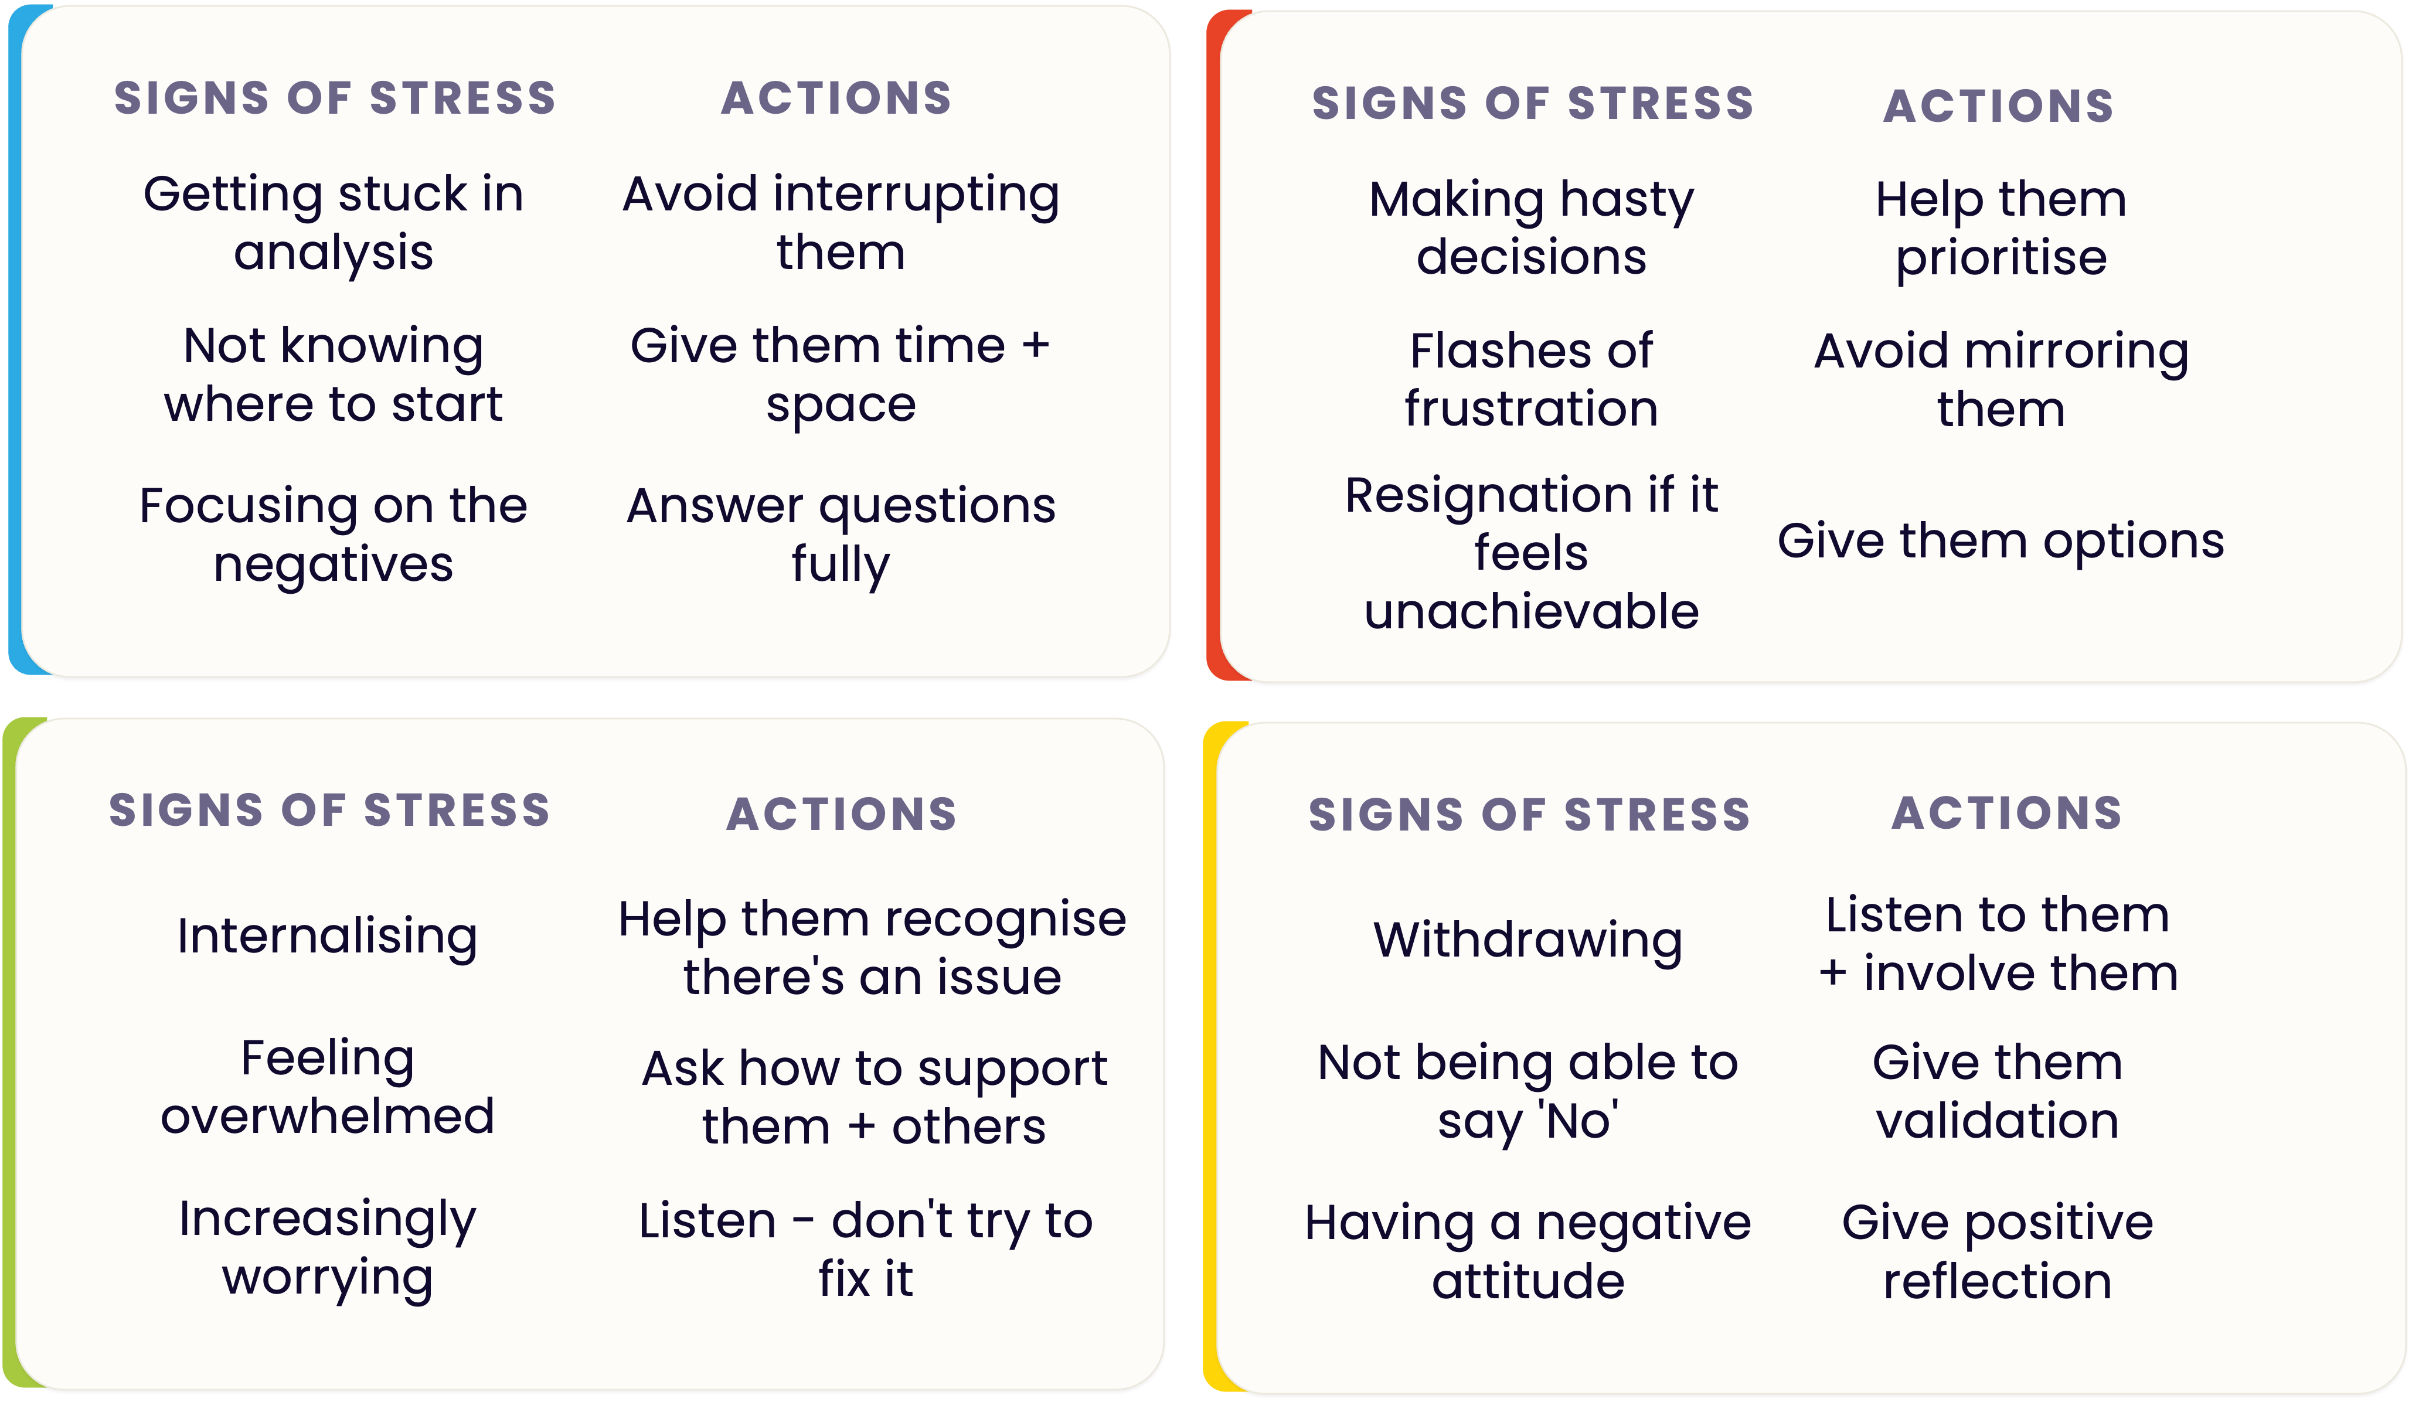
EXERCISE 8 · REFFERING TO YOUR PROFILE
Diffusing tension
Think of a relationship where there’s tension.
How might both your colour
preferences be impacting that
tension?
What actions could you take to flex your behaviour to diffuse the tension?
EXERCISE 8
Notes:
You'll find the stress and resilience visual in your profiles under the 'positive ways of handling setbacks' section.

Slide 30
GROUP EXERCISE
C-me 360 card game.
1
2
3
4
Bold and determined
Unites the team around shared values
Boundless energy for new tasks
A keen eye for detail
5
6
7
8
Can see both sides of an argument
Entertains colleagues when things get dull
Confronts issues head on
Explores all options
C-ME 360
Notes:
Explain 360 card game
Good exercise to start discussion on how we’re perceived by others in the team
Select one person in the group
The rest of the group then pick 2/3 cards which they feel best describe that person.
The selected person then gives some feedback about the cards that the rest of the
group selected for them.
Each person in the group has a go.
ACTION: Ask people to guess statements for one of the facilitators.

Slide 31
CARD COLOURS · REVEALED
C-me 360 reveal.
1
2
3
4
Bold and determined
Unites the team around shared values
Boundless energy for new tasks
A keen eye for detail
5
6
7
8
Can see both sides of an argument
Entertains colleagues when things get dull
Confronts issues head on
Explores all options
C-ME 360 · REVEAL
Notes:
Reveal the colours for each card.

Slide 32
NEXT STEPS · THROUGH ALL 4 COLOURS
Personal reflection
What more do I want to know?
What are my personal goals?
Each colour has a different perspective on the focus for action.
How could this impact others?
How can this be applied?
Consider all 4 colours to reflect on what you have learnt today.
What do you want to
stop … start … continue ?
PERSONAL REFLECTION
Notes:
Committing to actions to put into practice what we’ve covered over these sessions helps
to increase the impact of what you’ve learned.
We’ve mapped action planning around our wheel, illustrating how different elements look
through different colour lenses.
We all draw on all 4 colour energies in our daily lives, regardless of go to preferences, it’s just
that some we may have to be more intentional about than others …
Red – what personal goals are you going to set?
Yellow – what innovative applications can you think of?
Green – what impact might this have on others – how can I leverage what I’ve learned to impact
my team?
Blue – what theory and knowledge do I want to remember from this session?
STOP/START/CONTINUE: a helpful structure for reflection. What will you Start doing?
Stop doing? Continue doing?
Action: take 5mins now to complete this page.
Action: I’d like you all to enter in the chat box one key action point you’ve included in your plan …
Further comments you might want to make:
You or your client may want to include this in a personal development plan.
Personal commitments: goal orientation and ambition.
Innovative application: creative ideas around how you can apply what you’ve learned – at home, in meetings,
new ways to share or communicate insights, new ways to use your personalised C.
Impact on others: how can I leverage what I know to impact the teams I am a part of – share profiles and insights,
use to coach or line manage, use the team wheel for team meetings to create awareness of potential dynamics
and styles, enhancing comms and inclusivity.
Theory and knowledge: key takeaways from the sessions – we’re all different and unique? how to spot bad day
behaviours?

Slide 33
NEXT STEPS · THROUGH ALL 4 COLOURS
Team
reflection
What more do we want to know?
What are our personal goals?
Reflect on what you have learnt today through the lens of all 4 colours.
How could this impact others?
How can this be applied?
As a team what do you want to stop … start … continue ?
TEAM REFLECTION
Notes:
Opportunity for TEAM Reflection – vital to help embed the learning from this workshop in a collective way.
Encouragement to reflect on team group behaviours through the lens of all 4 colours (whilst we have a behavioural preference,
we are all a blend of all 4 colours).
STOP/START/CONTINUE: a helpful structure for reflection.

Slide 34
STAY IN TOUCH
Thank you.
Please stay in touch - we’d love to hear how you’re putting this into practice.
colour-profiling.com
@colourprofiling
@cmeprofiling
Cmecolourprofiling
@C-me Colour Profiling
FOUNDATION WORKSHOP
Notes:
Opportunity to thank everyone. Insert your own links here - replace the social handles with your own studio's links if relevant before delivery.

