Slide 1
FACILITATOR NOTES · PRE-SESSION
Preparing for your C-me session.
Certain slides can be hidden (right-click 'Hide Slide') depending on session needs. Certain slides will need editing for each session — see checklisbelow.
Ω
1
Profile
2
Home slide
A C-me profile is needed for every participant.
Option to add the client's logo / brand to Slide 3.
3
Aims
4
Face-to-face delivery
Adjust session aims as appropriate for the client — Slide 4.
If delivering face-to-face, hide slides 8 and 9
5
Pairs for Exercise 3
6
Communication slides
Select pairs for Exercise 3 in advance — Slide 16. See notes.
Slides 18–20 are currently hidden — not needed if the group has already done the Communication Workshop. If they have not, be aware of additional delivery time.
LEADERSHIP DEVELOPMENT WORKSHOP
Notes:
Pre-session admin slide. Run through the checklist before delivery:
• A C-me profile is needed for every participant.
• Add the client's logo / brand to the home slide (slide 3).
• Tailor the session aims on slide 4 as appropriate for the client.
• If delivering face-to-face, hide slides 8 and 9.
• Select pairs for Exercise 3 in advance (slide 16) — see notes.
• Slides 18–20 are currently hidden as they are not needed in this workshop if the group has already done the Communication Workshop. If they have not, be aware of additional delivery time

Slide 2
FACILITATOR NOTES · DELIVERY
Session delivery.
We encourage you to run through all the slides ahead of delivering them in slideshow mode. Some slides are static and others include animations — please check that the animations work as expected.
Brief notes are provided below each slide to give delivery guidance.
LEADERSHIP DEVELOPMENT WORKSHOP
Notes:
We encourage you to run through all the slides ahead of delivering them in slideshow mode. Some slides are static, others include animations — please check that the animations work as expected. Brief notes are provided below each slide to give delivery guidance.

Slide 3

C-ME WORKSHOP
C-me Leadership Development Workshop.
Helping teams communicate, collaborate
and perform at their best.
COLOUR-PROFILING.COM
Notes:
If delivering remotely:
Welcome everyone on grid view (share slides later).
Give a very brief personal introduction
Purpose: The purpose of this workshop is ……
Programme: The timeline for today is ….
If recording the session: Let the clients know at the start.

Slide 4

OUR AIMS FOR THIS SESSION · WHAT ARE YOURS?
Our aims for
this session.
01
Explore the specific leadership contributions for each colour preference
02
Reflect on your leadership style in the context of your personal profile
03
Consider how to best adapt your communication style and be more influential as a leader
04
Understand the impact of leadership style on communicating vision
+
What specific questions are you bringing?
AIMS
Notes:
Check these aims are appropriate for your clients and tailor if necessary.
Give space for participants to share their session aims in the chat.

Slide 5


C-ME PREFERENCE AROUND THE WHEEL
The C-me colour wheel
A keen eye for detail
Brings clarity to complexity
Direct and to the point
High-impact style
BLUE
002
BLUE
014
RED
015
RED
002
Enjoys problem solving
Explores all options
Bold and determined
Enjoys taking the lead
BLUE
041
BLUE
062
RED
047
RED
028
Aligns vision, values and behaviour
Considers impact on others
Brings positivity to any problem
Expressive and persuasive
GREEN
033
GREEN
051
YELLOW
033
YELLOW
005
A calming influence
Builds consensus
Flexible and adventurous
Juggles many tasks at once
GREEN
109
GREEN
012
YELLOW
021
YELLOW
066
THE WHEEL
Notes:
Let's start with a reminder of the C-me colour wheel - the heart of our approach to behavioural preference and how we represent it. It's a blended colour wheel - important because it reflects that we flex our behaviours to move around the wheel. The key here is that you can move; you're not stuck; there's room to develop and grow. Colours blend, numbers and labels don't. This is a non-binary approach - not boxing you in but giving you a common language to understand preference diversity and improve communication.

Slide 6
FROM CARL JUNG'S 4 QUADRANTS
C-me and the Jungian axes.
Thinking
PREFERENCE
Reflective
Expressive
PREFERENCE
PREFERENCE
Feeling
JUNGIAN AXES
PREFERENCE
Notes:
Very brief recap: how might the Jungian axes impact how a person leads?
Horizontal axis: how we make our decisions and how we relate to situations. Top of wheel = thinking - head. Bottom = feeling - heart.
Vertical axis. Right side = expressive preference (often labeled as extrovert). Left side = reflective preference. (often labeled as introvert)

Slide 7
EXERCISE · 360 CARD GAME
360 card game.
A keen eye for detail
Brings clarity to complexity
Direct and to the point
High-impact style
BLUE
BLUE
RED
RED
Explores all options
Bold and determined
Enjoys problem solving
Explores all options
Enjoys taking the lead
BLUE
RED
RED
BLUE
BLUE
RED
What do you observe about other team members ?
Aligns vision, values + behaviour
Considers impact on others
Brings positivity
Expressive and persuasive
GREEN
GREEN
YELLOW
A calming influence
Builds consensus
Flexible and adventurous
Juggles many tasks
YELLOW
GREEN
GREEN
YELLOW
YELLOW
360 CARD GAME
Notes:
Focussing on one Leader at a time - What would you say are their top 2 colour preferences? Add to chat
Explain the 360 card game if Face-to-Face:
8 cards given to each attendee
Consider each Leader in the room
Give a leader the cards that you think best describe them – max of 3 cards per leader
If virtual session, use slide 8

Slide 8
360 CARD GAME · CONSIDER ONE LEADER AT A TIME
Which statements resonate?
01
02
03
04
Bold, decisive and to the point.
Sees the big picture and the vision.
Energetic, persuasive, inspires the team.
Spontaneous, bringing flexibility and fun.
CARD 01
PICK · SKIP
CARD 02
PICK · SKIP
CARD 03
PICK · SKIP
CARD 04
PICK · SKIP
05
06
07
08
Builds trust and lasting relationships.
A steady, calming presence in the team.
Considered, accurate and thorough.
Analytical, logical, sets high standards.
CARD 05
PICK · SKIP
CARD 06
PICK · SKIP
CARD 07
PICK · SKIP
CARD 08
PICK · SKIP
360 CARD GAME
Notes:
Animated slide. Whole group to consider a leader and the resonance of statements for that individual. A new card will be revealed on each click. The colours of these cards will be revealed in the next slide.

Slide 9




360 CARD GAME · COLOURS REVEALED
The colour preferences behind each card.
01
02
03
04
Bold, decisive and to the point.
Sees the big picture and the vision.
Energetic, persuasive, inspires the team.
Spontaneous, bringing flexibility and fun.
CARD 01
RED
CARD 02
RED
CARD 03
YELLOW
CARD 04
YELLOW
05
06
07
08
Builds trust and lasting relationships.
A steady, calming presence in the team.
Considered, accurate and thorough.
Analytical, logical, sets high standards.
CARD 05
GREEN
CARD 06
GREEN
CARD 07
BLUE
CARD 08
BLUE
360 CARD GAME
09 / 31
Notes:
Colour preference will be revealed on each click.
Action: Identify the colours of the cards that you picked for that leader.
Action: Write those colours in the chat box/share with group.

Slide 10


Leadership +
management
LEADERSHIP & MANAGEMENT
Notes:
Very brief recap:
You can be an effective leader/manager from anywhere around the colour wheel.
You bring your own unique colour combination to your leadership role.
No one colour combination is better for leadership than another.
Often people make the assumption that red preference makes for the best leaders or even that this is
what is needed to lead: red = leadership. This is incorrect - in reality every colour preference brings
unique strengths to leadership and management.
Note. No matter what organisation it is, if leadership only reflects a certain specific style or preference then
this runs the risk of becoming the hallmark of what constitutes leadership, becoming one dimensional and
shutting the door to opportunity and innovation.
We want organisations to flourish drawing on diversity and inclusivity to harness the full spectrum of what its people
have to offer, growing in diverse styles of leadership, drawing on different behavioural preferences, maximising
engagement and productivity across the organisation.
Exercise: what are the strengths of each leadership style around the wheel? chat box/discussion.
Red – good day: visionary, quick decisive action, clarity of purpose, bold strategies – bad day: may feel controlling
and impatient, total focus on task, with little consideration for ensuring people are following.
Yellow – motivational, empowering individuals, inspiring innovation – bad day: unfocused, overwhelmed by amount
of possibilities, juggling too many things with no set timelines.
Green – nurturing, make sure whole team involved, collaboration, focus on values, purpose and quality – bad day:
procrastination, prolonged decision making in an effort to involve and gain agreement from everyone.
Blue – organised, clear timelines, realistic, ensures follow through, grounded, high standards – bad day: over analysis
creating a bottle neck, tension between timelines and needing to explore options, micromanagement, potentially slow
to delegate, lack of communication creating issue with buy-in.

Slide 11
AUTHENTIC LEADERSHIP STYLES · AROUND THE WHEEL
Authentic leadership styles.
Keeps the team on agenda
Good problem solver
Strong sense of duty
Logical + analytical
Sets high standards
Initiates vital improvements
Meets a challenge head on
Sets goals for the team
Works to tight deadlines
Explores all the options
Realistic
Well organised
Quick thinker
Builds enthusiasm
Visionary / sees big picture
Involves others
Works late till the job is done
Supportive + loyal
Spontaneous + imaginative
Thrives on variety
Positive + inspirational
Team player
Sees the good in others
Builds lasting relationships
AUTHENTIC LEADERSHIP STYLES
Notes:
Authentic leadership styles come in a range of colours.
with 4 colour quadrants (Y, G, B, R) and then blends accordingly.
Question: considering your top 2 colours and your blend, which 3 statements best describe you? Share as whole group, small group or pairs. Aim is to explore leadership styles around the wheel.

Slide 12
AUTHENTIC LEADERSHIP APPROACHES · WHAT EACH COLOUR SAYS
Authentic leadership approaches.
“Let’s deliver what we promised”
“Let’s do this right”
“Let’s make a big impact”
“Let’s set ourselves up for success”
“Let’s get this show on the road”
“Let’s do this together”
“Let’s give it our best shot”
“You’re the best team for the job”
LEADERSHIP APPROACHES
Notes:
Which statements do you use the most? Considering the colour preferences of your team, which ones are they likely to want to hear? What will you adjust in your communication as a result? Be specific.

Slide 13
FOUR POSTURES OF A LEADER
The four postures of a leader.
Take responsibility
Serve +
empower
Train + equip
Set example
FOUR POSTURES OF A LEADER
Notes:
Animated slide.
The dot represents the Leader in the positioning of each approach
1. Taking responsibility for everyone you are leading – leadership "down" (not bossing people
but taking responsibility)
2. Serving and empowering everyone you are leading – leadership "up"
3. Training and equipping those you lead – leading from behind (Management element)
4. Setting an example – leading from the front (Leadership)

Slide 14
FOUR POSTURES · REFLECTION
The four postures of a leader.
Take responsibility | Serve + empower
Train + equip | Set example
REFLECTION
Which of these postures is more intuitive
for you?
Is that what others see in you?
Thinking of a current situation, how might you adapt your intuitive leadership style to better effect?
FOUR POSTURES · REFLECTION
Notes:
Three questions for reflection (animated). Can be discussed as whole group, in small groups or pairs.
NB. There is not one posture for each colour quadrant. It is a more nuanced conversation about which postures come instinctively to each leader and which they might need to be more conscious of.

Slide 15
EXERCISE 2 · EXPLORE AND FILTER
On your own: explore + filter.
Look at the following sections of your personal profile, in the context of leadership: resilient strengths, team contribution , areas of development, blind spots.
RESONANCE
IMPACT
Which statements most resonate with you?
How are these showing up in your leadership?
REFLECTION
What might it feel like to be led by you?
EXERCISE 2
15 / 31
Notes:
Personal reflection on these sections of the report in the context of leadership, initially with a view to sharing in the next exercise.

Slide 16

EXERCISE 3 · SHARE
In pairs: share + reflect.
Working in pairs, look at your partner's statements.
PICK
STRENGTHEN + GROW
Pick 2 statements that best describe their leadership style.
How do these qualities strengthen the whole team and where is the most room for growth?
REFLECTION
An opportunity to hear another leader's perspective on your style. What did you learn? What surprised you?
EXERCISE 3
Notes:
Share whatever resonates from your individual reflections on the 4 areas of your report.
Pairs could be of those with opposite or very different colour combinations, or a pair who work closely together.
Opportunity to hear another leader's perspective on your style.

Slide 17
Break.
See you back here shortly.
LEADERSHIP DEVELOPMENT WORKSHOP
Notes:
Break.

Slide 18
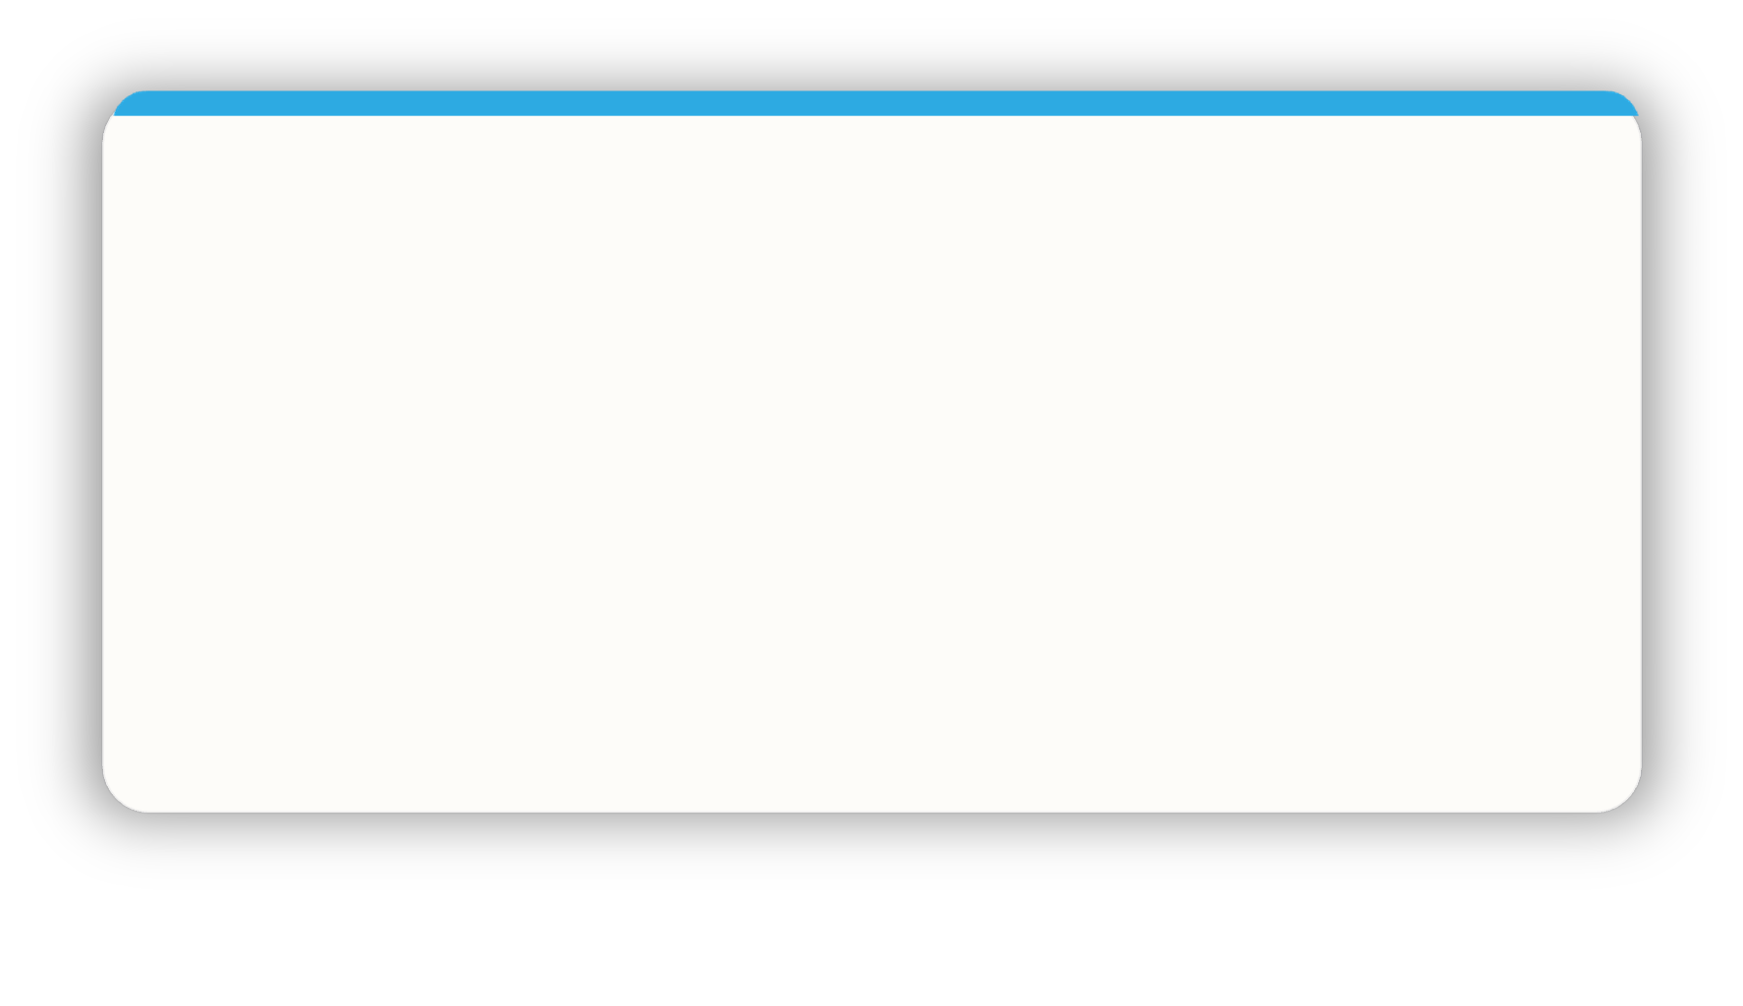
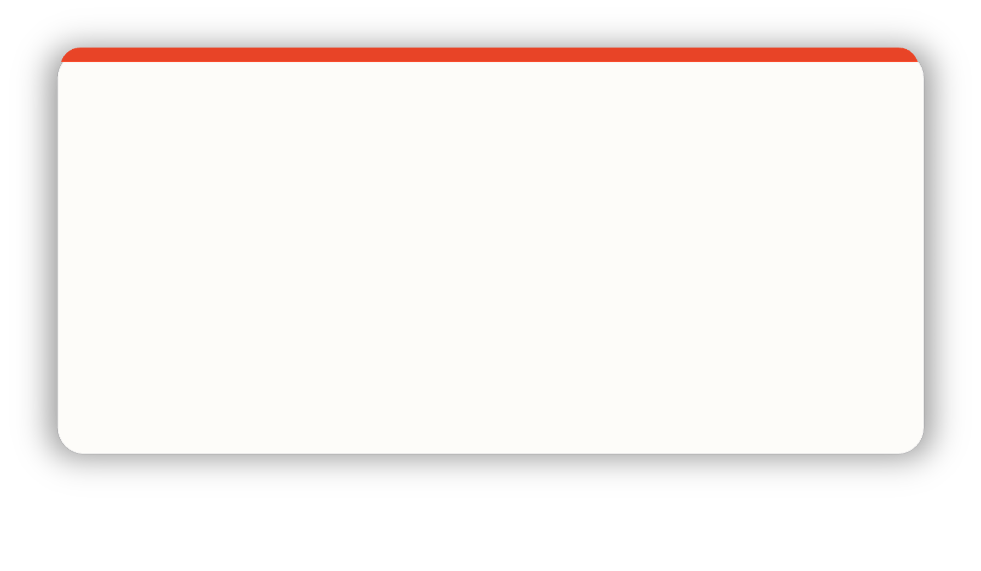
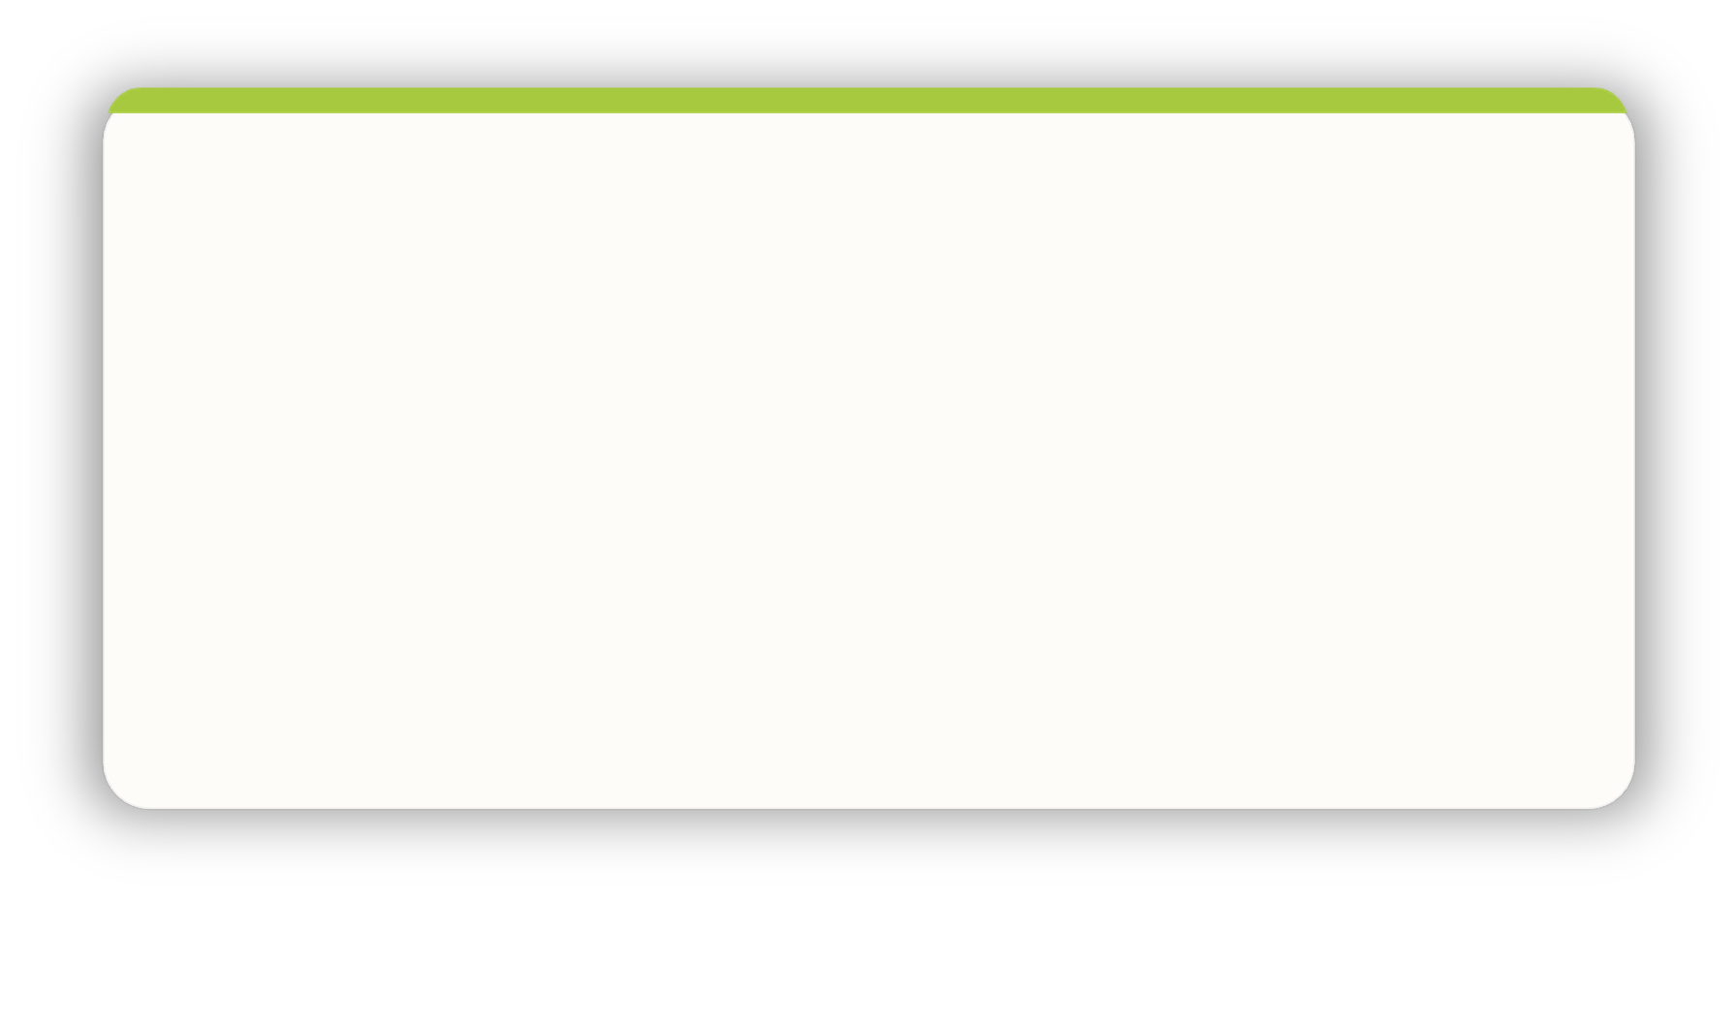
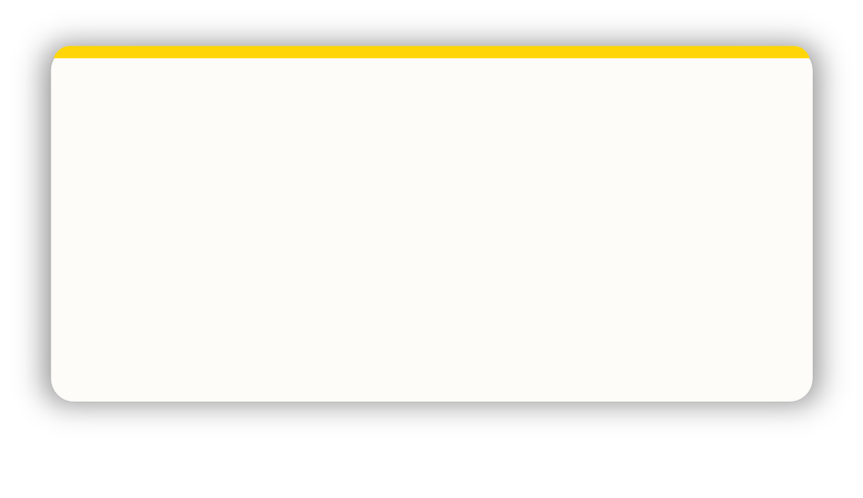
EFFECTIVE COMMUNICATION · DO …
Effective communication.
Be logical + thorough
Give me time to prepare
Be rational + practical
Ask me for my thoughts
Be clear + brief
Refer early to the objective
Demonstrate conviction
Identify my role quickly
Listen carefully
Show sincere interest
Involve others
Allow time for discussion
Allow conversation to be free flowing
Use visuals
Be interactive + informal
Let me shape the outcome
EFFECTIVE COMMUNICATION · DO
Notes:
Effective Leadership Communication
Different colours have very different preferences when it comes to effective leadership communication.
We often communicate in the style we are most comfortable with, rather than what is necessarily best for
the other person.
Action: Take a moment to look at the quadrant you’re most comfortable with and look across to the other
side of the wheel and take note of what is listed there.
For those who are a cross-type profile – use their lowest colour or the colour at the bottom of their 'C’
Visual.

Slide 19




INEFFECTIVE COMMUNICATION · DON'T …
Ineffective communication.
Skip over the facts
Stray from the agenda
Interrupt my thinking
Be flippant
Be impatient
Procrastinate
Slow down the pace
Repeat yourself
Be abrupt
Rush me
Talk over me
Openly criticise
Restrain my ideas
Overwhelm with detail
Dampen my enthusiasm
Expect me to stick to rigid timescales
INEFFECTIVE COMMUNICATION · DON'T
Notes:
Ineffective Colour Communication
This visual is again reinforcing colour preference behaviours and encouraging people to consider
other colours than their own.
Action: Take a moment to look at the quadrant you’re most comfortable with and look across to the
other side of the wheel and take note of what is listed there. What does someone of opposite colour
preference to you really not find helpful?
For those who are a cross-type profile – use their lowest colour or the colour at the bottom of their 'C’
Visual.

Slide 20
VERBAL STYLE · HOW LEADERS SOUND AROUND THE WHEEL
Verbal style.
Pragmatic
Structured
Professional
Analytical
Prepared
Authoritative
Direct
Fast paced
Unambiguous
Assured
Collaborative
Diplomatic
Thoughtful
Empathetic
Meaningful
Dynamic
Persuasive
Spontaneous
Positive
Informal
VERBAL STYLE
Notes:
Recap verbal style. The most effective leaders learn to pick up nuance and the subtleties of differences in verbal style — not about what is said but how.
Note: pause for brief reflection to allow attendees to consider situations that occur to them relating to this.

Slide 21

EXERCISE 4 · EXPLORE, FILTER, SHARE
Exercise 4: explore, filter, share.
Look at the following sections of your own profile.
ENABLING ENGAGEMENT
ROLE AGILITY
Which 3 statements best describe what keeps you engaged and committed as a leader?
Which 3 statements best describe your role preference and how you respond to change?
REFLECTION
In what ways does this impact your leadership?
EXERCISE 4
21 / 31
Notes:
Personal reflection on these sections of the report in the context of leadership.

Slide 22
COACHING MODEL
Being C.L.E.A.R in our leadership.
Commit
Purpose + goal of the conversation
Review
Session + process
Action
Clarify next steps
Listen
Ask exploratory questions
Explore
Look at options
C.L.E.A.R COACHING
22 / 31
Notes:
Each Click – reveals next part of the C.L.E.A.R Coaching Method for communicating as Managers
and Leaders.
This process can be used in any topic or issue that needs addressing between a Leader and one of the
team.
To develop your leadership further, in this exercise you are considering your own colour preferences and
those of someone you coach.
When coaching others, it is beneficial to go through all 5 stages, not just the ones they more naturally
focus on:
Commit – Clarifying goal or issue and the purpose of the conversation. A collaborative approach to this
is best.
Listen – Ask open questions, collect detail and information and allow time for reflection. Reflect back
what you have heard.
Explore – Explore together the avenues available to get to the agreed goal, based on what you have just heard.
Action – Gain clarity on next steps to achieve agreed goal.
Review – 1. Session review - Ask for feedback on how they found the session and consider adjusting your style
accordingly for next time. 2. Process review - Review ongoing progress. Give time for reflective input soon after
the session for those who would value it.
As coaches, our different colour preferences make some of these stages more intuitive than others.
Which stages are intuitive for you?
Which ones do you need to flex to intentionally, for the sake of the Coachee?
Do these relate to your colour preferences?
Why CLEAR model over GROW model? Firstly, it makes explicit the importance of the wider dynamics,
encouraging questions like "How did you find our conversation?", "What helps you learn?" and "What
blocks your learning?".
Secondly the CLEAR model emphasises the importance of reviewing the session. This is a powerful tool
for tuning our coaching to the evolving needs of the other person. It's easy when using the GROW model
to feel that when we have done the wrap-up, we're finished. Making reviewing the coaching effectiveness
one of the basic steps, as the CLEAR model does, reinforces the value and importance of this stage and allows
for more consideration of the other person's preferences.

Slide 23

EXERCISE 5 · APPLYING C.L.E.A.R IN OUR LEADERSHIP
Applying C.L.E.A.R.
EXERCISE: THINK OF SOMEONE YOU ARE CURRENTLY LEADING…
Commit
What is their colour preference?
Which stages are they likely to want to focus on?
Which are they likely to want to skip over?
Purpose + goal of the conversation
01
Listen
02
Ask exploratory questions
03
Explore
Look at options
Action
Clarify next steps
REFLECTION
Review
Flexing involves adjusting our own preferences to support all 5 stages
to maximise the outcomes of the conversation.
Session + process
EXERCISE 5
23 / 31
Notes:
Animated – to reveal the flexing statement at the bottom of the slide.
As Leaders it is good to adjust ourselves to the preferences of others, potentially being more conscious
of the stages that are less conscious for the person concerned.

Slide 24
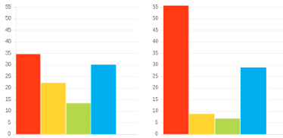
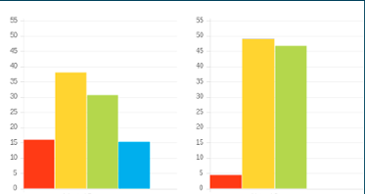
EXERCISE 6 · APPLYING C.L.E.A.R
In pairs: Applying C.L.E.A.R
In pairs, explore how the C.L.E.A.R. method could be best adjusted for 2 different profiles. Focus primarily on the adapted graph.
Commit
Purpose + goal of the conversation
Listen
Profile 1
Profile 2
Ask exploratory questions
ADAPTED · NATURAL
ADAPTED · NATURAL
Explore
Look at options
Action
Clarify next steps
Review
Session + process
Be aware of the natural 'unconscious' graph and 'revert to type' behaviours.
EXERCISE 6
24 / 31
Notes:
In pairs, explore how the C.L.E.A.R. method could be best adjusted for 2 different profiles.
Note: focus primarily on the adapted graph. Note: but be aware of the natural 'unconscious' graph and 'revert to type' behaviours.

Slide 25

PERSONAL REFLECTION
Personal reflection.
Consider 2 key team members with different colour preferences to you.
DAY TO DAY
NEXT COACHING
How will you adapt your day-to-day communication style with them from now on?
What changes will you make in a coaching session with them next time?
PERSONAL REFLECTION
25 / 31
Notes:
Give 3 minutes for each individual to consider. Questions are animated.

Slide 26
VISION · EACH COLOUR'S QUESTION OF FOCUS
Vision.
HOW?
WHY?
How are we doing it?
What is the process?
Why are we doing it?
What is the goal?
WHO?
WHAT?
Who will be impacted?
Who will be affected?
What can we do differently? What are the options?
VISION
26 / 31
Notes:
Animated – each click reveals each colour.
Each colour preference is likely to have a different question of focus with regards to vision.
So the question each colour preference would ask might be...
Why - What is the goal?
What - What are the options?
Who – Who will be affected?
How – What is the process?
Great that we all have natural questions we would ask but we also need to ask the other questions
intentionally in order for the whole picture to be created.

Slide 27
EFFECTIVE VISION · WHAT EACH COLOUR BRINGS
Effective vision.
Vision + process
Vision + decision
= Order
= Progress
Vision + collaboration
Vision + ideas
= Buy-in
= Inspiration
EFFECTIVE VISION
27 / 31
Notes:
Animated — each click reveals each colour. Each colour preference's contribution brings an important part of the vision. Which come naturally to you? Who do you turn to for the others?

Slide 28
INEFFECTIVE VISION · WHAT HAPPENS WITHOUT EACH COLOUR
Ineffective vision.
Vision - process
Vision - decision
= Chaos
= Theory
Vision - collaboration
Vision - ideas
= Disengagement
= Limitation
INEFFECTIVE VISION
28 / 31
Notes:
Animated — each click reveals each colour. Vision without one of the key elements quickly becomes ineffective. Thoughts?

Slide 29
EXERCISE 7 · COMMUNICATING VISION
Powerfully communicating vision
HERE
Vision involves taking people from here to there.
THERE
01
02
03
What adjustments would you make when communicating vision to people with colour preferences different to your own?
Which might you want to be more aware of in your communication of vision?
How might this be impacting your team?
EXERCISE 7
29 / 31
Notes:
Animated questions.
Vision involves taking people from here to there.

Slide 30
FINAL REFLECTION
Final reflection.
What more do I want to know?
What are my personal goals?
01
What do people most appreciate about how you lead?
02
How can you better release the potential in others?
How could this impact others?
How can this be applied?
03
How will you lead differently in light of this workshop?
FINAL REFLECTION
Notes:
Committing to actions to put into practice what we’ve covered over these sessions helps
to increase the impact of what you’ve learned.
We’ve mapped action planning around our wheel, illustrating how different elements look
through different colour lenses.
We all draw on all 4 colour energies in our daily lives, regardless of go to preferences, it’s just
that some we may have to be more intentional about than others …
Red – what personal goals are you going to set?
Yellow – what innovative applications can you think of?
Green – what impact might this have on others – how can I leverage what I’ve learned to impact
my team?
Blue – what theory and knowledge do I want to remember from this session?
STOP/START/CONTINUE: a helpful structure for reflection. What will you Start doing? Stop doing? Continue doing?
Action: take 5mins now to complete this page.
Action: I’d like you all to enter in the chat box one key action point you’ve included in your plan …

Slide 31
STAY IN TOUCH
Thank you.
Please stay in touch . We'd love to hear how you're putting this into practice.
LEADERSHIP DEVELOPMENT WORKSHOP
31 / 31
Notes:
Opportunity to thank everyone. Insert your own links here on this slide.

