Slide 1
C-me powerpoint brand sheet
Please stick to these protocols for brand consistency
Slide Title: Franklin Gothic Bold 36pt
  Sub-headings: Franklin Gothic Regular 24pt
    Explanatory Text: Franklin Gothic Regular 18pt
    Background Colour Palette:
    Text Colour Palette:
C 91
M 54
Y 26
K 40
R 20
G 62
B 86
C 74
M 28
Y 16
K 5
R 65
G 134
B 162
C 52
M 10
Y 11
K 1
R 117
G 179
B 196
©2014 Colour Preferences Ltd | www.colour-profiling.com

Slide 2
Preparing for your C-me session
N.B. Certain slides can be hidden (right click ‘Hide Slide’) depending on session needs N.B. Certain slides will need editing for EVERY different delivery (see below)
CHECKLIST
For this session you will need the High Performance Influencer report.
Home Slide: Option to add Client’s / Team's logo/brand Slide 5
Session Aims Slide 5 - remember to adjust if you adapt the slide deck
You may wish to add in an Animated Timer at the Break point Slide 17 (Go to "Insert" tap > "Add ins")
Insert their Team Wheel Slide 22
©2014 Colour Preferences Ltd | www.colour-profiling.com

Slide 3
Session Delivery
We encourage you to run through all the slides ahead of delivering them in slideshow mode. Some slides are static and others include animations. Please check that these animations work.
Be aware that the Timer slide animation can corrupt.
Brief notes are provided below each slide to give delivery guidance.
©2014 Colour Preferences Ltd | www.colour-profiling.com

Slide 4



Welcome to your C-me
Sales and Influencing Workshop
Helping you and others to perform at their best
Insert bespoke logo here
©2014 Colour Preferences Ltd | www.colour-profiling.com
Notes:
If delivering remotely:
WELCOME everyone on grid view (share slides later).
Give a very brief personal introduction
PURPOSE: The purpose of this workshop is ……
PROGRAMME: The timeline for today is ….
If RECORDING SESSION: Let the clients know at the start.

Slide 5

Our Aims for this session
Recap Colourful Behaviours
Consider personal sales strengths and blind spots
Consider Team sales strengths and blind spots
Review sales drivers and blockers around the wheel
Apply learning to maximize sales performance
What are your aims?
©2014 Colour Preferences Ltd | www.colour-profiling.com
Notes:
Check these aims are appropriate for your clients and tailor if necessary.
Give space for participants to share their session aims in the chat.

Slide 6

Remember the C-me Axes?
Recap
Here are the Jungian axes.
What are the 4 titles?
Thinking preference
Reflective
preference
Extraverted
preference
Feeling preference
©2014 Colour Preferences Ltd | www.colour-profiling.com
Notes:
Reminder of C-me Axes from Foundation Workshop. 2 clicks reveal the labels for each axes. The aim is to recap and will be expanded over the session.

Slide 7

Thinking/Feeling Behaviours
Business-like
Self-contained/controlled
Pragmatic/focussed
Critical
Independent
Orderly and organised
Timescales are important
Body language more rigid
Asks pointed questions
Less facial expression
More formal
Considerate / caring
Flexible
Shows feelings
Easier to get to know
Questions less pointed
People issues come first
More emotional
Smiles more
More casual
Comfortable
Responsive
People first
©2014 Colour Preferences Ltd | www.colour-profiling.com
Notes:
Thinking/Feeling Axis - Aim is to recap on how different colour behaviours show themselves.

Slide 8
Reflective/Extravert Behaviours
Thinks before responding
Contributes more slowly
Takes time to commit
Leaves room for others' views
Less direct eye contact
Considerate and gentle
Quiet, even cautious
Fewer gestures
Needs more personal space
More diplomatic language
Thoughtful/Slower pace
Responds quickly
May interrupt/fills silences
Conversational
Spontaneous
Sounds sure of “facts”
Gives direct eye contact
Stands physically closer
More intrusive/more gestures
May show impatience
May challenge more directly
Future focused
More optimistic
©2014 Colour Preferences Ltd | www.colour-profiling.com
Notes:
Reflective/Extravert Axis - Aim is to recap on how different colour behaviours show themselves.

Slide 9
Effective approach to sales
Exercise 1:
Considering we are all different, what are the implications for your approach to sales and customer service?
Thinking preference
Reflective
preference
Extraverted
preference
Feeling preference
©2014 Colour Preferences Ltd | www.colour-profiling.com
Notes:
Discuss and share in groups

Slide 10
Sales approach
Discernment
Accurate
Right way to do things
Thorough in research
Analyses the problem
Defines buying motive
Happy to close
Negotiator
Moves on quickly
Follows correct process
Keeps records well
Timely reporting
Networker
Enthusiastic
Convincing presentation
Builds LT relationships
Considerate
Wins trust
Provides innovative ideas
Interactive
Builds rapport
Understands needs
Takes personal interest
Develops relationship
©2014 Colour Preferences Ltd | www.colour-profiling.com
Notes:
Consider
Looking around the colour wheel, notice the very different sales approaches different colour preferences have.
How do other people in your sales team differ from yourself? In what ways might this complement you?

Slide 11

Reviewing your Personal Influencer Report
Exercise 2:
Overview (p4)
Sales strengths and sales improvement areas (p10)
Explore Filter Share
©2014 Colour Preferences Ltd | www.colour-profiling.com
Notes:
Overview of what we are going to cover in the next few slides.
Take 5 mins individually to read these areas of your report again
Explore together in the context of sales and customer service and answer the questions in your report.

Slide 12
Effective Communication
Recap effective communication around the wheel.
Exercise 3:
Review your personalized statements (p7).
What comes most naturally to you when wanting to influence others?
Share.
Give facts, ideally in writing
Be rational and practical
Ask for their questions
Discuss the principles
Be logical and thorough
Listen carefully to questions
Allow time to prepare
Demonstrate conviction
Identify their role quickly
Be direct and action focused
Present options
Focus on success
Be clear and brief
Refer early to the objective
Allow time for discussion
Listen carefully
Show sincere interest
Be polite and courteous
Consider their opinions
Be sensitive; feelings matter
Progress at their relaxed pace
Be interactive and friendly
Use visuals
Allow free flow
Be light and fast paced
Make direct eye contact
Seek their views and ideas
Allow for an open discussion
©2014 Colour Preferences Ltd | www.colour-profiling.com
Notes:
Fixed image on this slide are there as additional statements to select from as well as personalised report statements.
- ACTION: Review your personalised statements on p7 of the Influencer Report through the lens of sales. Which statements best apply when you sell? Which ones do you think you most use in the context of sales and Customer service? When you are in discussion with Clients? When you first make connection with a prospective client?
Give people 2 mins for self reflection and then split into groups. Sharing could be done in pairs or whole group, as appropriate.

Slide 13
Ineffective Communication
Recap ineffective communication around the wheel.
Exercise 4:
Review your personalized statements (p7).
Which statements most resonate with you?
Share.
Interrupt their train of thought
Be flippant
Skip over the facts
Be unrealistic
Fill thinking silences
Jump between topics
Give facts without back-up
Be impatient
Expect an easy ride
Be too soft
Belittle accomplishments
Forget their need for control
Insist on giving lots of detail
Waffle or procrastinate
Ask for an instant decision
Be abrupt
Openly criticise
Ruin the harmony
Rush the discussion
Talk over them
Be pushy or abrasive
Prevent their dreams
Cut them off in mid flow
Assume you know better
Give a tight set of rules
Assume they are listening
Overwhelm with detail
Pour cold water on their ideas
©2014 Colour Preferences Ltd | www.colour-profiling.com
Notes:
Recap Ineffective Colour Communication around the wheel
- ACTION: Remind yourself of what you find most difficult in how others communicate with you and recap that communication is very different depending on colour preference.
Review your personalised statements on p7 of the Influencer Report through the lens of sales. Which statements best apply when you sell? Which ones do you think you most use in the context of sales and Customer service? When you are in discussion with Clients? When you first make connection with a prospective client?
Give people 2 mins for self reflection and then split into groups. Sharing could be done in pairs or whole group, as appropriate.

Slide 14
Communicating to others
Exercise 5:
  Scenario: A client keeps stalling on making a commitment to purchase
  How would you naturally communicate with them?
  How well would this connect if they were: 1. Red/Blue
  2. Green/Yellow 3. Yellow/Red 4. Blue/Green 5. Red/Green
©2014 Colour Preferences Ltd | www.colour-profiling.com
Notes:
Aim – Consideration of the need to "flex" communication styles in order to get the best from the other person.
Think Jungian axes! We are introducing colour combination here too.
N.B.
1. Red/Blue = Thinking
2. Green/Yellow = Feeling
3. Yellow/Red = Extroverted
4. Blue/Green = Reflective
5. Red/Green = Cross-type

Slide 15
Optimising Sales Performance
Performance = POTENTIAL minus INTERFERENCES
3 interferences:
1. CONFIDENCE – mindset is key
2. CREDIBILITY – believability/reputation
3. CONNECTION – build trust
How might YOUR colour preference impact these interferences?
©2014 Colour Preferences Ltd | www.colour-profiling.com
Notes:
Eg. Someone of high Yellow/Red preference may have higher levels of confidence but may not take the time for connection with the individual and could come across as a bit pushy.
Consider which colour preferences might have more or less of these interferences

Slide 16
Exercise 6: Flexing to others
Where will you have to flex in order to be effective?
  Scenario 1 Your potential client has the complete opposite colour preference to you
  Scenario 2 Your current client is not responding to any emails
  Scenario 3 Your current client’s financial position has changed and they are no longer able to afford your services
©2014 Colour Preferences Ltd | www.colour-profiling.com
Notes:
Discussion as whole team or small groups:
Scenario 1: Simple scenario - flexing to opposite colour
Scenario 2 – More nuance of communication skills needed. Your email communication style in emails will be shaped by your colour combination so needs careful thought.
Scenario 3 – Needs careful thought on how far you will push for result or keep the relationship (for a later date?), depending on your colour preference.

Slide 17
BREAK
©2014 Colour Preferences Ltd | www.colour-profiling.com
Notes:
Group Discussion on how the second colour can impact stress triggers and responses
NB. There is always more nuance than looking through the lens of 4 colours only

Slide 18
Coaching each other
The next 2 slides will reflect on verbal style and body language displayed when influencing others. Work in pairs to coach each other in the following 3 areas:
Provide examples of where your colour strengths have been a real asset
Provide observations of where your natural approach can hinder effective influencing
Where do you most intentionally need to develop in order to display greater flexing in your approach?
©2014 Colour Preferences Ltd | www.colour-profiling.com
Notes:
Working in pairs to share specific real life scenarios where this has played out. Good for developing stronger team dynamics and individual improvement and accountability.

Slide 19
Verbal Style
Pragmatic
Controlled
Orderly / formal
Questioning
Critical
Detail focused
Can be ‘nit-picky’
Direct
Fast paced
Quick response
Spontaneous
May interrupt
Forthright
Confident
Exercise 7:
Your colour strengths
Possible hindrances
Flexing opportunity
Ask not tell
Diplomatic
Slower pace of speech
Keeps opinions to self
Gentler approach
Quiet tones
Thinks first
Flitting topic to topic
Fast paced
Expressive
Positive possibilities
Emotional
Personal
Enthusiastic
©2014 Colour Preferences Ltd | www.colour-profiling.com
Notes:
Personal reflection and then coaching each other on the following:
Provide examples of where your colour strengths have been a real asset
Provide observations of where your natural approach can hinder effective influencing
Where do you most intentionally need to develop in order to display greater flexing in your approach?

Slide 20
Body Language
Exercise 8:
Your colour strengths
Possible hindrances
Flexing opportunity
Keeps personal space
Less facial expression
Little physical contact
More formal
Detached
Less expressive
Leans forward
Firm handshake
Full eye contact
Assertive
Bold gestures
Stands closer
Reserved
Few gestures
Intermittent eye contact
Little touch until familiar
Gentle handshake
Warm
Smiles
Open / relaxed
Good eye contact
Responsive
Animated
Plentiful gestures
©2014 Colour Preferences Ltd | www.colour-profiling.com
Notes:
Personal reflection and then coaching each other on the following:
Provide examples of where your colour strengths have been a real asset
Provide observations of where your natural approach can hinder effective influencing
Where do you most intentionally need to develop in order to display greater flexing in your approach?

Slide 21
Effective Communication by Email
Accurate spelling and grammar
Keep professional/formal
Attach detail if possible
Schedule calls in advance
Provide context
Keep focused / brief
Use bullet points
Put the action in the subject line
Tell them why they are getting this email
Arrange brief face-to-face meeting
Ask how they are
Express interest in non-work matter
Use a friendly tone throughout
Include practicalities
Email ahead to provide reflection time
Say it over the phone if possible
Be chatty, sociable and fun
Not too long
No detailed attachments
Visuals are good
©2014 Colour Preferences Ltd | www.colour-profiling.com
Notes:
Personal reflection and then coaching each other on the following:
Provide examples of where your colour strengths have been a real asset
Provide observations of where your natural approach can hinder effective influencing
Where do you most intentionally need to develop in order to display greater flexing in your approach?

Slide 22
Sales Team Wheel
Exercise 9:
  What might be the natural strengths of this Sales Team?
  What might be possible blinds spots for this Sales Team?
  Where might you have to show most flex as a team?
  Insert Team Wheel here
©2014 Colour Preferences Ltd | www.colour-profiling.com
Notes:
Up until now, we have reflected on Sales from a personal point of view. We are now moving on to consider a Team Perspective.
Reflecting on your Sales Team Wheel, discuss:
What might be the natural sales strengths of this Sales Team?
What might be possible blind spots for this Sales Team?
Where might you have to show most flex as a team? (N.B. Look at the graphs on p2 of your Team Wheel which suggest areas for team flex)

Slide 23

Exercise 10: Sales drivers
Efficiency savings
Streamlines processes
Saves money
Increases stability
Aids organisational structure
Provides security
Growth agenda
Increase profitability
Raise profile
Expand market share
Measure performance
Generate tangible outcomes
Purposeful impact
Implements values
Improves team wellbeing
Empowering employees
Growing engagement
Concern for relationships
Early adopter
Exciting innovation
New opportunities
Reduces mundane work
Involves meeting new people
Forging new partnerships
©2014 Colour Preferences Ltd | www.colour-profiling.com
Notes:
Reflect on Sales Drivers for different colour preferences around the wheel. Can be done in small groups or pairs.
Think of a particular current potential client.
What are your Client's KEY DRIVERS that you need to tap into in order to close a deal?
What implications does this have for your personal approach to sales? Your team’s approach to sales?
Share as a whole team as appropriate.

Slide 24
Exercise 11: Sales blockers
Lack of evidenced research
Lack of factual data
Demanding an immediate decision
Insufficiently clear process
Too slow to implement
Cost without tangible benefit
Lack of short-term results
Disconnected from strategy
Causing team conflict
Requires change too fast
Not engaging stakeholders
Lack in alignment with values
Requires long-term commitment
Out-dated technology
Limits future options& relationships
Lack of ‘big picture’ impact
©2014 Colour Preferences Ltd | www.colour-profiling.com
Notes:
Reflect on Sales Blockers for different colour preferences around the wheel. Can be done in small groups or pairs.
Think of a particular current potential client.
What are your Client's KEY BLOCKERS that you need to tap into in order to close a deal?
What implications does this have for your personal approach to sales? Your team’s approach to sales?
Share as a whole team as appropriate.

Slide 25
Securing a commitment
Ensure they’ve got space to make a well reasoned decision
Make sure they’ve got all the info they need and answer questions carefully
Avoid applying pressure / rushing
Focus on solutions and present clear options
Be assertive and upfront about what you want – apply some pressure
Create an urgent business case
Give sufficient time to make a decision and don’t pressure them!
Give them time to check consensus
Communicate about what support will be offered along the customer journey
Clarify the window of opportunity – apply some pressure
Emphasise the vision and what you can make possible
Give time to fostering the relationship
©2014 Colour Preferences Ltd | www.colour-profiling.com
Notes:
For information only - This slide provides some suggestions for the most effective ways of securing a commitment for each of the 4 colour preferences.
Reflect – How does this link with a potential sales deal you are experiencing currently. What changes, if any, will you make?

Slide 26
Planning your pitch checklist
Know your own profile – What are your natural communication strengths and blind spots?
Consider your audience – What is their (likely) colour preference?
‘Flex’ your pitch – What do they most need to think / feel?
Review as you go – Is your approach connecting? What could you do to adjust?
Record learning for others – What went well? What went not so well?
– What would you do differently next time?
©2014 Colour Preferences Ltd | www.colour-profiling.com
Notes:
Personal reflection. In reviewing the planning checklist...
Where are your natural strengths?
Where do you need to be most intentional?
What might you adjust in future?

Slide 27
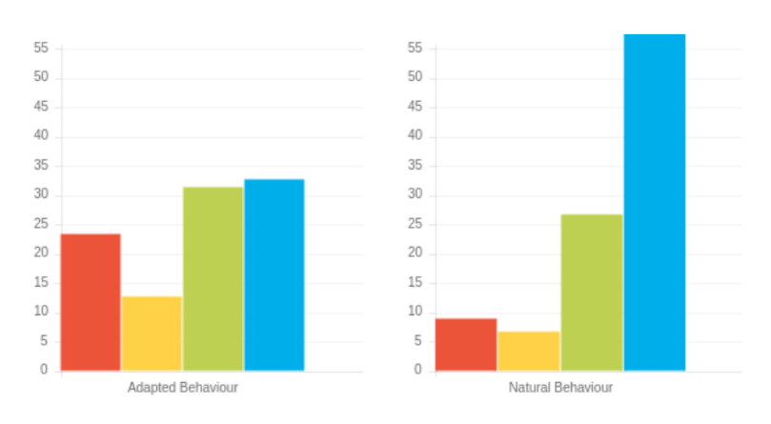
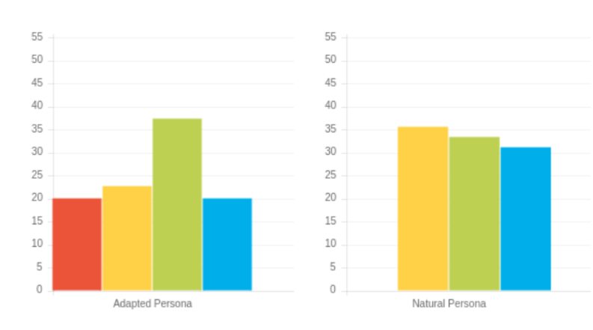
1
Exercise 12: Planning your pitch
Reflecting on the two Client Profiles on the right:
  What are their probable needs, motivations and communication preferences?
  What will you need to ensure you do to enhance the sales process for them?
1
2
©2014 Colour Preferences Ltd | www.colour-profiling.com
Notes:
Embedding the "planning your pitch" idea and pulling together everything we have explored in the Workshop.
Work in pairs.

Slide 28
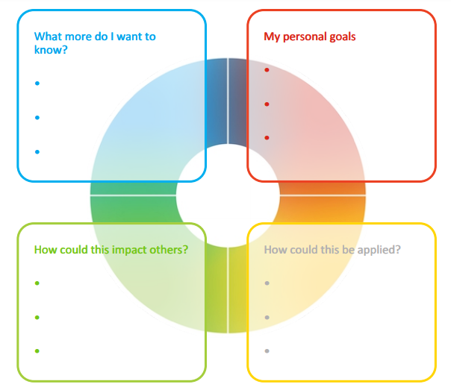
Action Planning
Reflect on what you have learnt today through the lens of all 4 colours.
What was the most helpful insight you have gained from this workshop?
What one thing do you need to watch out for in order to ensure optimal sales effectiveness?
What do you want to commit to:
  Stop? Start? Continue?
©2014 Colour Preferences Ltd | www.colour-profiling.com
Notes:
Opportunity for TEAM Reflection – vital to help embed the learning from this workshop in a collective way.
Encouragement to reflect on team group behaviours through the lens of all 4 colours (whilst we have a behavioural preference, we are all a blend of all 4 colours).
STOP/START/CONTINUE: a helpful structure for reflection.
The thing you may decide you want to stop may be something that reflects your highest colour preference.
Also the thing you may decide to start may be drawing on another colour other than your top colour preference.

Slide 29





Thank you and please stay in touch!
Colour-profiling.com
@colourprofiling
@cmeprofiling
Cmecolourprofiling
@C-me Colour Profiling
©2014 Colour Preferences Ltd | www.colour-profiling.com

