Slide 1

C-me powerpoint brand sheet
Please stick to these protocols for brand consistency
Slide Title: Franklin Gothic Bold 36pt
  Sub-headings: Franklin Gothic Regular 24pt
    Explanatory Text: Franklin Gothic Regular 18pt
    Background Colour Palette:
    Text Colour Palette:
C 91
M 54
Y 26
K 40
R 20
G 62
B 86
C 74
M 28
Y 16
K 5
R 65
G 134
B 162
C 52
M 10
Y 11
K 1
R 117
G 179
B 196
©2014 Colour Preferences Ltd | www.colour-profiling.com

Slide 2
Preparing for your C-me session
N.B. Certain slides can be hidden (right click ‘Hide Slide’) depending on session needs N.B. Certain slides will need editing for EVERY different delivery (see below)
CHECKLIST
You will need the High Performance or Core report of this workshop.
Home Slide: Option to add Client’s / Team's logo/brand Slide 4
You may wish to add in an Animated Timer at the Break point Slide 29 (Go to "Insert" tap > "Add ins")
Insert correct Report Page Number for Exercise 5 Slide 35
Insert bespoke Team Wheel Slide 37
Insert bespoke Team graphs Slide 38
©2014 Colour Preferences Ltd | www.colour-profiling.com

Slide 3
Session Delivery
We encourage you to run through all the slides ahead of delivering them in slideshow mode. Some slides are static and others include animations. Please check that these animations work and work as you are expecting.
Brief notes are provided below each slide for delivery guidance.
©2014 Colour Preferences Ltd | www.colour-profiling.com

Slide 4

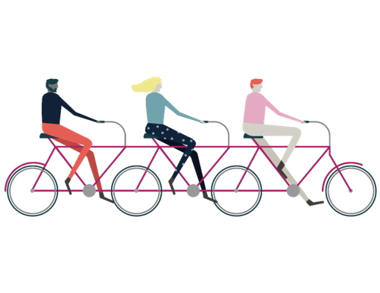
Welcome to your C-me
Stress & Resilience Workshop
Helping you and others to perform at their best
Insert bespoke logo here
©2014 Colour Preferences Ltd | www.colour-profiling.com
Notes:
If delivering remotely:
WELCOME everyone on grid view (share slides later).
Give a very brief personal introduction
PURPOSE: The purpose of this workshop is ……
PROGRAMME: The timeline for today is ….
If RECORDING SESSION: Let the clients know at the start.

Slide 5
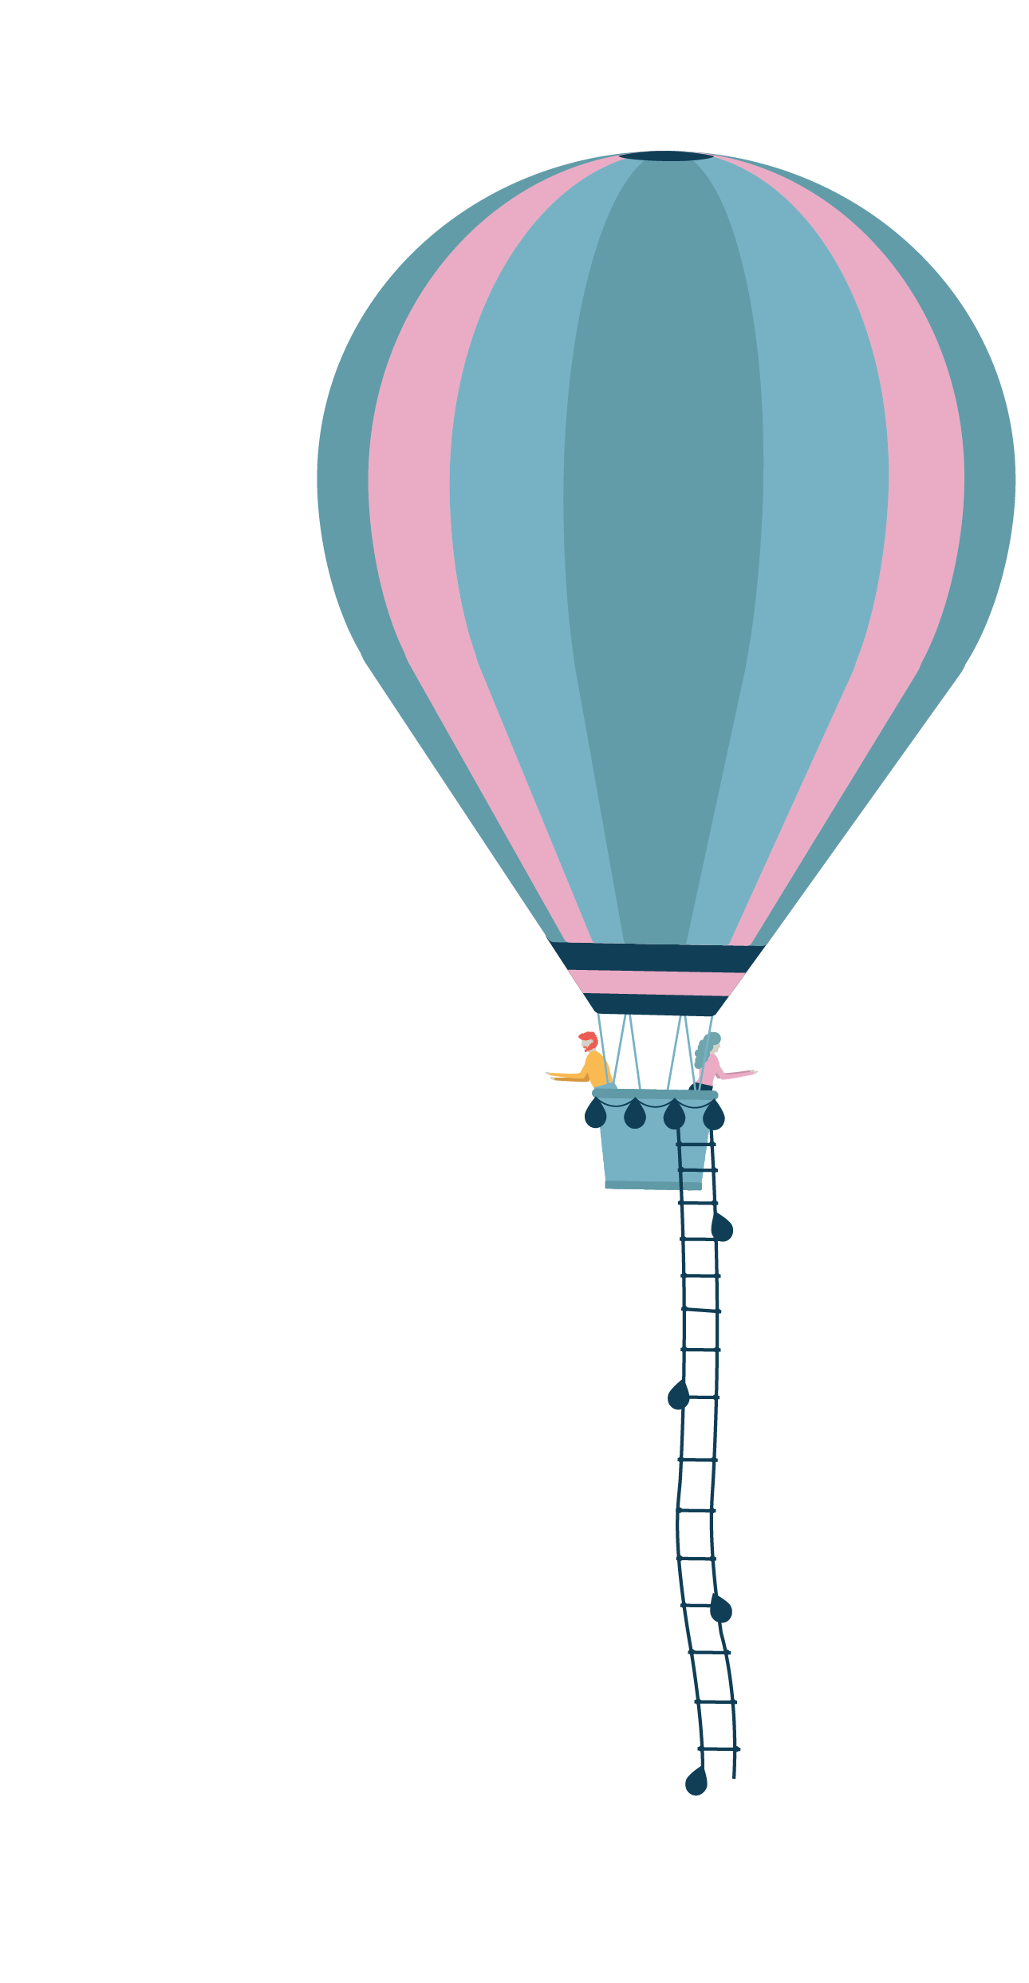
Session Aims
Better understand resilience in the context of C-me
Learn how to spot the signs of stress in self and others
Reflect on the impact of stress on our behaviours
Grow in ability to adapt behavior in order to build resilience
What are your specific aims for this session?
©2014 Colour Preferences Ltd | www.colour-profiling.com
Notes:
Check these aims are appropriate for your clients and tailor if necessary.
Give space for participants to share their session aims in the chat/on flipchart.

Slide 6

Impact on others
Behaviours
Personality
(values, beliefs)
©2014 Colour Preferences Ltd | www.colour-profiling.com
Notes:
Emphasize that C-me focus on BEHAVIOURS, not personality.

Slide 7
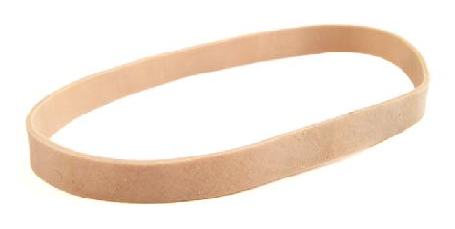
Understanding Resilience
From the Latin ‘resiliens’
- ‘to rebound’, to ‘bounce back’
“The process of adapting well in the face of adversity, threats or significant stress”
American Psychological Association
Exercise 1: Reflect
How resilient do you feel you are as:
i) an individual ii) a team iii) an organization?
2. What has happened recently that has tested your resilience?
3. Where have you seen colleagues respond effectively?
©2014 Colour Preferences Ltd | www.colour-profiling.com
Notes:
What do you think Resilience is?
Why an elastic band? When stretched it will not break and will rebound back to it's original size when the pressure is off. If overstretched, will lose elasticity or even break!
These exercises can be done as individual reflection time or group discussion.

Slide 8
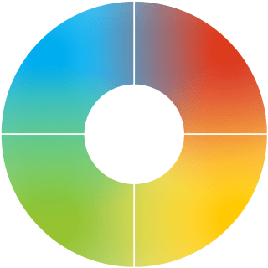
Resilient Strengths
Realistic & considers all the facts
Focuses on details & brings clarity
Strong work ethic & sticks to principles
Decisive, bold and determined
Drives hard to deliver results
Enjoys a challenge
Tactful, diplomatic and open minded
Strong, reliable and conscientious
Kind, considerate & dedicated to team
Sociable, enthusiastic & outgoing
Positive, generous & open minded
Creative & embraces change
©2014 Colour Preferences Ltd | www.colour-profiling.com
Notes:
A summary of resilient strengths and development areas of each colour. Use after discussion as a summary and remember we’re looking at resilience not competence.
Resilience = where we perform at our best and for the longest time given any task.
Not about what we’re good at but what gives us life and energy.
You may be very good at things that are your lowest colour but it might drain you to do it.
Example: Someone who is good at detailed, systematic administrative tasks but when their energy is low, planning goes out the window, details are missed and balls are dropped. Competence is high but resilience is low.
Colour does give us clues as to where we gather energy, so if we’re in a role that demands our lowest colour we need to look at how to structure our day in practical ways to work effectively for longer.

Slide 9
Understanding Stress
From the Latin ‘stringere’
- ‘to draw tight’
‘A state of mental or emotional strain or tension, resulting from adverse or demanding circumstances’
Exercise 2: Reflect
How does stress impact
  i) you? ii) your team? iii) your organisation?
©2014 Colour Preferences Ltd | www.colour-profiling.com
Notes:
The aim is to begin to explore how stress impacts us in different ways

Slide 10
Exercise 3: Stress Test
For each question, mark which statement best describes you
1.
2.
3.
4.
5.
6.
7.
8.
9.
©2014 Colour Preferences Ltd | www.colour-profiling.com
Notes:
ACTION: Please recreate this grid on your paper, drawing two columns, with the numbers 1-9 down the left-hand column.
N.B. Whilst your clients are drawing the grid, it’s helpful for you to draw the grid at the same time in order to get your pace right.
A series of statements (labelled A,B,C,D) will appear on the screen. Identify the statement that best describes your behaviour when under stress and write down that letter in the right hand column next to the corresponding number.

Slide 11
C-me Stress Test
Question 1 – When I am stressed, I …
Become hypersensitive to my own and others' emotions.
Blurt out harsh words and critical statements about others.
Feel disapproved of, disliked and rejected by others.
Make up “logical plots” and rationalisations to explain situations.
©2021 Colour Preferences Ltd | www.colour-profiling.com
Notes:
Allow clients time to read the slide and record their answer.

Slide 12
C-me Stress Test
Question 2 – When I am stressed, I …
Misinterpret comments from others as personal criticism.
Put others down by pointing out their mistakes.
Become disorganised, chaotic and rush around.
Become compulsive in search of the “truth”.
©2014 Colour Preferences Ltd | www.colour-profiling.com

Slide 13
C-me Stress Test
Question 3 – When I am stressed, I …
Feel like a victim, unappreciated and used.
Make decisions too quickly and display knee jerk reactions.
Become forgetful and misplace things.
Turn to experts for advice, complaining if they don’t know everything.
©2014 Colour Preferences Ltd | www.colour-profiling.com

Slide 14
C-me Stress Test
Question 4 – When I am stressed, I …
Become defensive and feel threatened.
Become increasingly impatient and irritable.
Become over-emotional and argumentative.
Become concerned about not appearing “professional”.
©2014 Colour Preferences Ltd | www.colour-profiling.com

Slide 15
C-me Stress Test
Question 5 – When I am stressed, I …
Become overly concerned about the welfare of others.
Become impatient with people who are not as quick.
Become fearful of other people’s disapproval.
Withdraw and become pessimistic seeing only the downside in everything.
©2014 Colour Preferences Ltd | www.colour-profiling.com

Slide 16
C-me Stress Test
Question 6 – When I am stressed, I …
Become stubborn.
Start to micro-manage and seek to control all outcomes.
Become manipulative and coercive.
Become excessively rigid and rule-bound.
©2014 Colour Preferences Ltd | www.colour-profiling.com

Slide 17
C-me Stress Test
Question 7 – When I am stressed, I …
Shut down and worry excessively.
Become inflexible in decision making (I am right).
Lose focus and become easily distracted.
Look for perfection rather than an 80/20 solution.
©2014 Colour Preferences Ltd | www.colour-profiling.com

Slide 18
C-me Stress Test
Question 8 – When I am stressed, I …
Feel devalued as a human being.
Make caustic remarks about others.
Blame others for not appreciating me.
Engage in excessive logic.
©2014 Colour Preferences Ltd | www.colour-profiling.com

Slide 19
C-me Stress Test
Question 9 – When I am stressed, I …
Feel fragile and needy.
Order people around.
Start to chase my tail but get very little done.
Become aloof and detached.
©2014 Colour Preferences Ltd | www.colour-profiling.com

Slide 20
C-me Stress Test Results
1. | A
2. | B
3. | B
4. | D
5. | A
6. | C
7. | C
8. | D
9. | B
A: Operating with Green preference under pressure
B: Operating with Red preference under pressure
C: Operating with Yellow preference under pressure
D: Operating with Blue preference under pressure
Which 2 colours do you have most of?
Share what you have learned?
©2014 Colour Preferences Ltd | www.colour-profiling.com
Notes:
You should have something that looks like this.
2nd Click: TASK: Ask participants to ‘analyse’ their personal stress test.
The highest scoring colours suggest likely behaviours under stress.
How do your results compare with your report graph?
Highlight the blend of colours in their answer choices.

Slide 21
Signs of stress
Becomes impatient and negative
Gets stuck in analysis
Feels overloaded and becomes distant
Gets frustrated & hasty in decision-making
Drives too hard & is over-focused
Gets discouraged & negative
Internalises & feels overwhelmed
Gets anxious, withdraws, goes quiet
Becomes less supportive
Becomes chaotic & easily distracted
Struggles to say ‘no’
Tends to over-communicate
©2014 Colour Preferences Ltd | www.colour-profiling.com
Notes:
Summary slide after discussion, to reinforce learning.
Starting with blue preference, what do you thing the signs of stress are? Yellow preference next, then Green preference, then Red preference.

Slide 22
Yerkes-Dodson Human Performance Curve
Performance
High performance
Boredom
Stress zone
Flip zone
Comfort
Stretch
Strain
Flip
Pressure
©2014 Colour Preferences Ltd | www.colour-profiling.com
Notes:
The Yerkes–Dodson law is an empirical relationship between pressure and performance.
Originally developed by psychologists Robert M. Yerkes and John Dillingham Dodson in 1908.
The law dictates that performance increases with physiological or mental arousal, but only up to a point.
The positions of High Performance, Stress and Flip zone are animated to appear on 3 clicks as this curve is being explained.

Slide 23
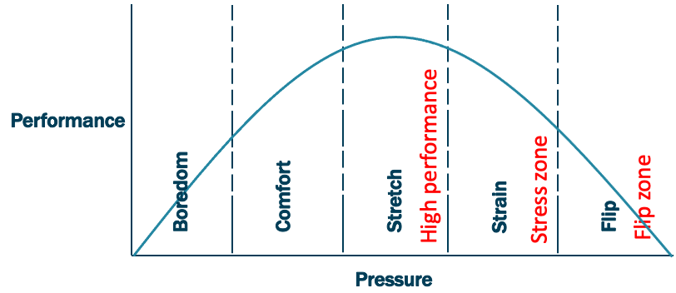
Yerkes-Dodson and C-me
1
2
3
1
2
3
©2014 Colour Preferences Ltd | www.colour-profiling.com
Notes:
Mapping the Yerkes-Dodson Human Performance Curve onto the C-me Colour Wheel
1. High performance zone – playing to your resilient colour strengths
2. Stress zone – beginning to stray beyond the bounds of your resilient strengths (stress is triggering ‘bad day’ behaviours)
3. Flip zone – Bad day behaviours are being played out in an extreme (now a long way from operating in the High Perfomance Zone (best utilising resilient strengths)
Expanded in the next few slides
N.B. C-me wheel is a behavioural tool – looking at probable behaviours and behavioural styles (responses to stress are not ALWAYS predictable!)

Slide 24
High Performance (Stretch Zone)
Playing to your colour strengths
Focused
Detailed
Organised
Reflective
Critical thinker
Decisive
Determined
Action orientated
Confident
Assertive
Supportive
Values focused
Intentional
Considerate
People orientated
Creative
Inspiring
Motivated
Visionary
Positive
©2014 Colour Preferences Ltd | www.colour-profiling.com
Notes:
Stretch zone.
Animated slide Red preference, Green preference, Blue preference, Yellow preference.

Slide 25
Triggers that take us into the stress zone
Incoherent plans
Insufficient preparation time
Last minute changes
Too many ideas
Loss of control
Too slow a pace
Too much detail
Endless discussion
Feeling rushed
Devaluing of others
Conflict & tension
Undermining of values
Exclusion
Disapproval or criticism
Too much focus on detail
Lack of collaboration or fun
©2014 Colour Preferences Ltd | www.colour-profiling.com
Notes:
Starting with those of us with high Blue preference, what triggers stress in you? Yellow preference next, then Green preference, then Red preference.
The arrows signify leaving the High Performance Zone, into the Stress Zone.

Slide 26
Observed behaviours in the stress zone
Negativity
Getting stuck in analysis
Overloaded
Unresponsive, distant
Frustration
Rushed decisions
Overly zealous
Impatience
Anxiety
Being overwhelmed
Internalising & distancing
Becoming less supportive
Chaotic decision making
Distraction
Inability to say ‘no’
Loss of creativity
©2021 Colour Preferences Ltd | www.colour-profiling.com
Notes:
Possible to discuss link with "bad day" behaviours.
Green preference, Yellow preference, Red preference, Blue preference.
Which do you recognise in yourself? Other people you know well or work with?

Slide 27
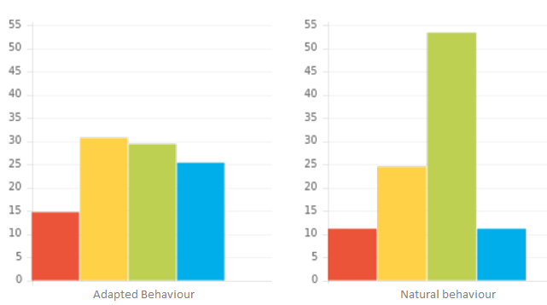
Stress Zone
N.B. Unfiltered, less-conscious graph
©2014 Colour Preferences Ltd | www.colour-profiling.com
Notes:
Stress leads us to ‘revert to type’ – unfiltered / less conscious behaviours. We see our natural graph colours exhibiting.

Slide 28
Flip Zone – Moving from stress to panic
Erratic
Uncalculated risks
Inability to prioritise
Overly emotional
Hyper-sensitive
Indecisive
Overly ‘pushy’
Impetuous
Callous
Becomes highly rigid
Fixated by details
Stops communicating
©2014 Colour Preferences Ltd | www.colour-profiling.com
Notes:
Animated slide where colour boxes and arrows appear – Blue preference, Green preference, Yellow preference, Red preference.
In panic mode, we enter the Flip Zone and our behaviours are perhaps surprisingly seen coming from the opposite side of the wheel.
Sometimes in this zone we exhibit the "bad day" behaviours of that opposite colour, which can surprise us and others!
Can you think of a situation where this has been true for you?

Slide 29
BREAK
©2014 Colour Preferences Ltd | www.colour-profiling.com

Slide 30




Exercise 4: Stress and Colour Combination
How might stress play out for these colour combinations?
Person 1 Person 2 Person 3 Person 4
©2014 Colour Preferences Ltd | www.colour-profiling.com
Notes:
Group Discussion on how the second colour can impact stress triggers and responses.
NB. There is always more nuance than looking through the lens of 4 colours only.

Slide 31
How do we manage/coach?
Returning to the High Performance Zone
Give them time & space
Answer questions fully
Present the facts
Avoid interrupting them
Avoid mirroring behaviour
Leave alone
Give options
Help them to prioritise
Listen don’t fix
Re-visit the values
Help them recognise issue
Ask how to support them
Compliment successes
Involve them
Listen to them
Give them validation
©2014 Colour Preferences Ltd | www.colour-profiling.com
Notes:
Each colour preference will respond well to managing or coaching back to high performance in different styles.
The fixed image in the HP+ Report on the Setbacks and Stress page has these suggested approaches too.

Slide 32
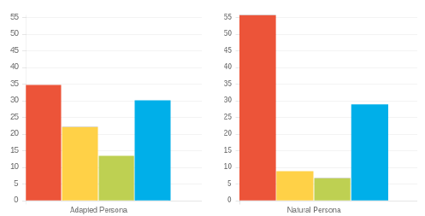
Exercise 5: Coaching back to high performance
How might stress be triggered?
How will this stress be displayed?
3. What behaviours should be avoided when supporting this person?
4. How could this person be coached back to High Performance?
Adapted Behaviour
Natural Behaviour
©2014 Colour Preferences Ltd | www.colour-profiling.com
Notes:
Work through the slide exercise questions.
In this example:
N.B. Naturally high Red Preference – possible ‘bad day’ behaviours associated with red preference that are likely to be shown under stress
N.B. Higher R/B preference in Natural suggests reverting to thinking/task type under pressure (people/team/feelings may get forgotten)
N.B. Steadier behavioural ‘balance’ of Adapted profile is likely to become more pronounced and extreme under pressure.
N.B. Refer to behaviours to avoid (slide 34) for ideas on what to avoid doing.
COACHING:
Initially give space/provide options/perspective
Later encourage leaning into G/Y preference behaviours – valuing other perspectives.

Slide 33



Coaching out of stress
Name | C’s | Do | Don’t
Jonny
Sally
Fred
©2014 Colour Preferences Ltd | www.colour-profiling.com
Notes:
Illustrate how teams can be proactive in coaching one another out of Stress and back towards High Performance. This is a similar grid to the Do's and Don'ts of communication. Encourage Team to create their own grid.

Slide 34
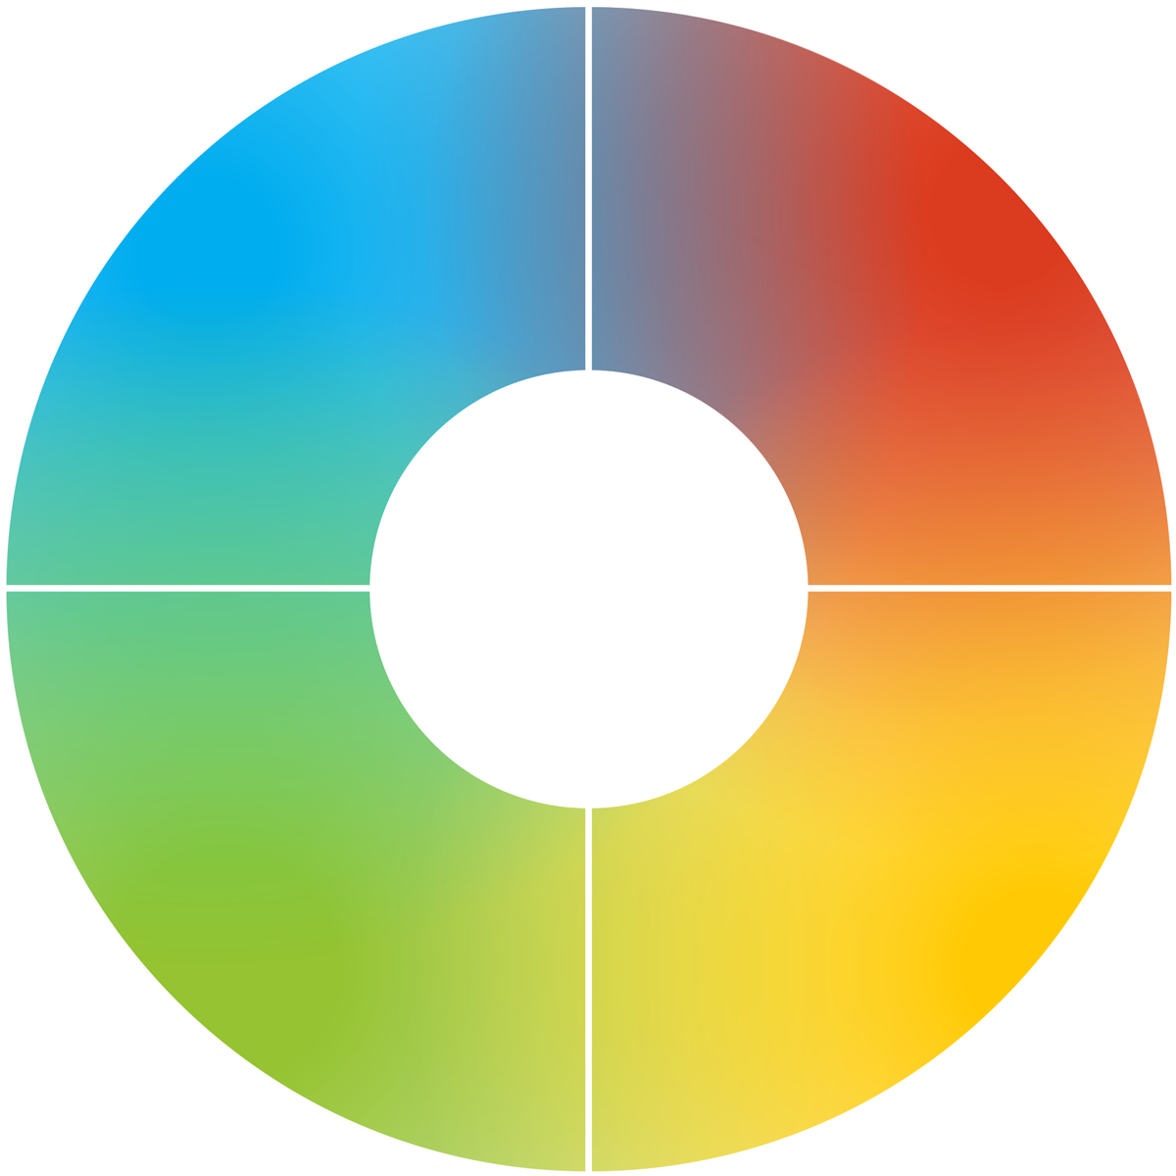
Response to setbacks
How each colour preference is likely to respond
Looks for facts
Will look for a logical solution
May see worst in a situation
Looks to sort it quickly
Decisive
Can appear rushed
Can feel overwhelmed
Concerned for others first
Reluctant to respond quickly
Will see the opportunities
Keen to work collaboratively
Can miss details
©2014 Colour Preferences Ltd | www.colour-profiling.com
Notes:
Looking specifically at our verbal style
- How do we like to talk to people?
- How might other people prefer talking to us?

Slide 35
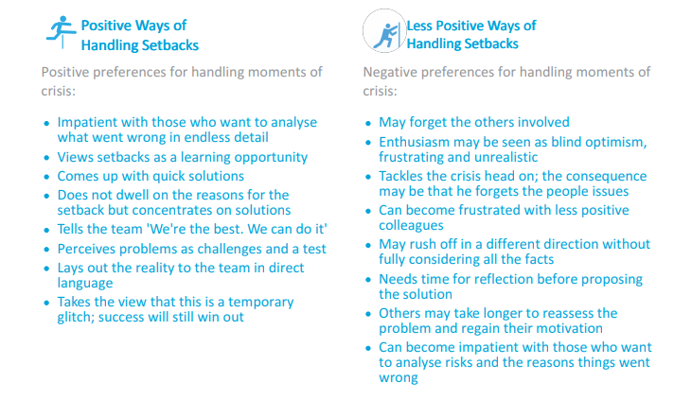
Handling setbacks
Exercise 5
Look at the Handling Setbacks section of your report – page ?
Pick two statements from each column that most resonate with you.
Share in pairs how an awareness of these things will help you better handle setbacks in the future.
©2014 Colour Preferences Ltd | www.colour-profiling.com
Notes:
How are setbacks different from stress? What is a setback?
Refer to personal High Performance Reports P10 to complete the exercise.

Slide 36
Flexing behaviours to build resilience
Explore feelings
Find the fun in challenges
Value other perspectives
Stay connected to
purpose and life dreams
Take on tasks which
require attention
Commit to a task or decision
Stick to deadlines
& healthy routines
Utilise analysis and rigour
©2014 Colour Preferences Ltd | www.colour-profiling.com
Notes:
DISCUSS: What do you notice about the most effective ways of building resilience?
To build resilience, try to lean into your natural opposite colour preference. Consciously choosing to practice these skills that are less familiar to your colour preferences (flexing) will help you perform better and will also build resilience for when things are under more pressure.

Slide 37
Reflecting on stress as a team
Team wheel
Reviewing last year and key projects, what have the stress points been for you as a team?
How does this relate to your team wheel?
What changes could you make to handle these stress points better as a team in the future?
Insert team wheel
©2014 Colour Preferences Ltd | www.colour-profiling.com
Notes:
An opportunity here to apply the learning of this workshop to the team collectively.

Slide 38
Reflecting on stress as a team
Team graphs
What are the most likely triggers of stress for this team collectively?
What do you need to commit to intentionally as a team in order to overcome this?
Insert team graphs
©2014 Colour Preferences Ltd | www.colour-profiling.com
Notes:
The team graphs could reveal resilient/high scoring colour strengths that are not necessarily being fully utilised currently. Addressing this can impact resilience for overcoming stress as a team.

Slide 39
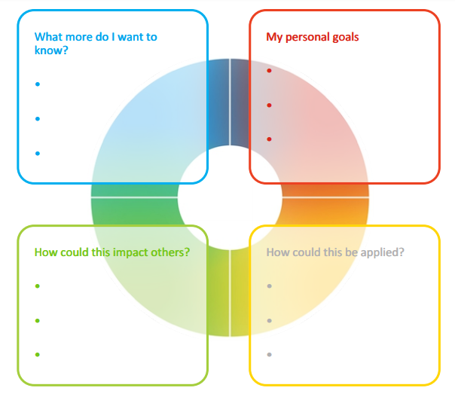
Final Reflection
Each colour has a different perspective on the focus for action. Consider all 4 colours to reflect on what you have learnt today.
What do you want to commit to Stop, Start and Continue
        Personally?
        As a Team?
©2014 Colour Preferences Ltd | www.colour-profiling.com
Notes:
Opportunity for PERSONAL and TEAM Reflection – vital to help embed the learning from this workshop.
Encouragement to reflect on behaviours through the lens of all 4 colours (Whilst we have a behavioural preference, we are all a blend of all 4 colours) for Action Plans that are more thorough.
STOP/START/CONTINUE: a helpful structure for reflection. What will you Start doing? Stop doing? Continue doing?

Slide 40




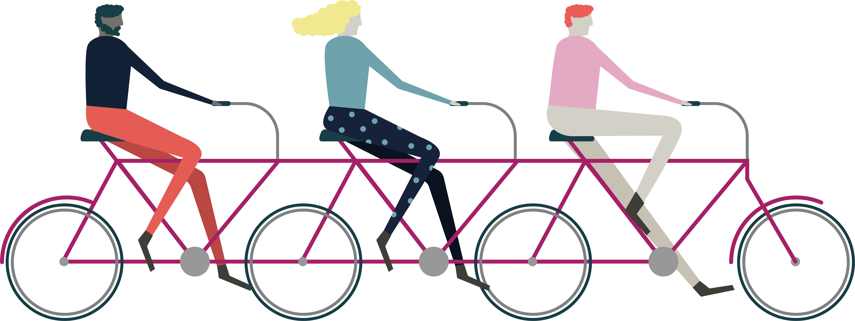

Thank you and please stay in touch!
Colour-profiling.com
@colourprofiling
@cmeprofiling
Cmecolourprofiling
@C-me Colour Profiling
©2014 Colour Preferences Ltd | www.colour-profiling.com
Notes:
Opportunity to thank your guests!
Please add in your own contact details if you want to.

